Slide 1
Essential computational thinking: Chapter 05
Dr. Ricky J. Sethi
Essential Computational Thinking

Slide 2
Chapter 5
Control Structures

Slide 3
The story so far…
The process that affects the transformation of the Data to Information is an Algorithm
  Data was Temperature Values
  Process was Average + Threshold
  Information: Is it cold or not?
An algorithm is the step-by-step procedure
This consists of Control Structures that control the flow of execution of the algorithm
Data
Process
Information
Process
Knowledge

Slide 4
Computer Programs
What exactly is a computer program?
  A detailed, step-by-step sequence of instructions telling a computer what to do.
  If we change the program, the computer performs a different set of actions or a different task.
  The machine stays the same, but the program changes!
Programs contain the instructions that are executed, or carried out, by the CPU
All program instructions are translated to binary
  Binary is all the CPU really understands since it consists of switches

Slide 5
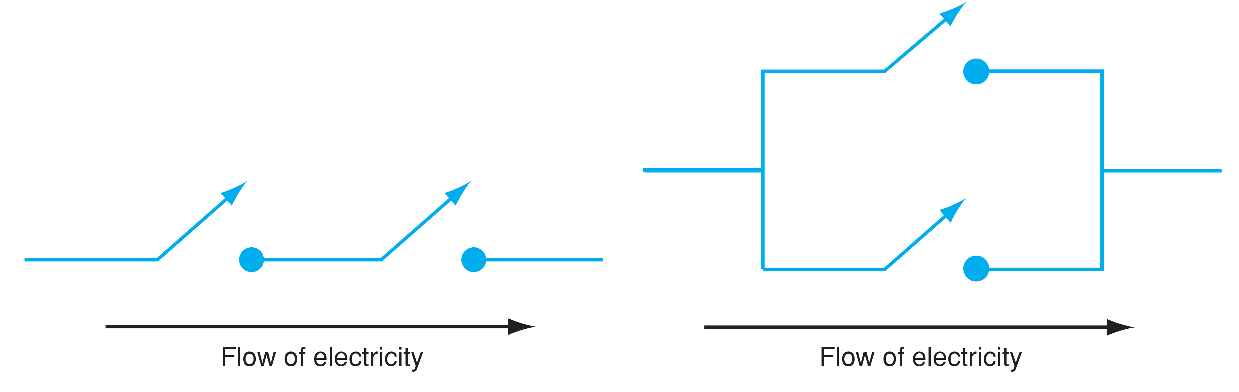
CPU Contains Switches
These switches can be used to construct more complicated functions
Functions such as Boolean circuits: like and switches (on the left) and or switches (on the right)
These functions can then be combined to carry out basic operations on data
  E.g., Arithmetic Operations,
  memory operations, etc.

Slide 6
Memory, CPU, and Instructions
A computer’s memory contains both programs and data
  This is the von Neumann architecture
  Main memory is fast, but volatile; i.e., when the power is interrupted, the contents of memory are lost.
    Secondary memory provides more permanent storage: magnetic (hard drive, floppy), optical (CD, DVD), etc.
  The CPU can only directly access data stored in main memory, the Random Access Memory (RAM)

Slide 7
CPU Uses the Fetch-Execute Cycle
The Fetch-Execute Cycle involves:
  FETCHing, or retrieving, the first instruction from memory
  Decoding the instruction to see what it represents
  EXECUTING, or carrying out, the appropriate action
  FETCHING the next instruction, decoding it, and executing it
  Rinse, lather, repeat!

Slide 8
The Universal Machine
All modern computers follow the same prescription
  Programs are the instructions for the computer to execute (carry out)
A modern computer can be defined as “a machine that stores and manipulates information under the control of a changeable program.”
Three key elements:
  Computers are devices for manipulating information.
  Computers operate under the control of a changeable program.
  von Neumann architecture: data + programs in the same memory space

Slide 9
Turing Machines
In 1936, Turing was interested in the question of what it means for a task to be computable
Intuitively, a task is computable if it is possible to specify a sequence of instructions which will result in the completion of the task
Turing proposed a class of devices to develop a formal notion of computation
  Originally called a-machines (automatic machine) now called Turing Machines
  Turing reformulated Kurt Gödel's 1931 results on the limits of proof and computation
  He replaced Gödel's universal arithmetic-based formal language with these formal and simple hypothetical devices

Slide 10
The Turing Machine
A hypothetical Turing Machine can do three things:
  Write/Delete a symbol
  Move the tape head Left/Right
  Go to a new or same state
Programs are executed, or carried out, by these Turing machines
  All computers have the same power, with suitable programming
    I.e., each computer can do the things any other computer can do.
  CONCLUSION: a machine with the correct minimal set of operations can calculate anything that is computable

Slide 11
Minimal instruction set for the CPU
  All computer programs can be written using just these five instructions. All programs, ever!
  LOAD A: load contents at RAM address A into accumulator
  STORE A: store accumulator contents into address A in RAM
  CLR: clear accumulator
  INC: increment accumulator
  BRZ X: branch to address X in RAM if accumulator is zero

Slide 12
Structured Program Theorem
The structured program theorem, also called Böhm-Jacopini theorem, is a result in programming language theory.
It states that a class of control flow graphs (historically called charts in this context) can compute any computable function if it combines subprograms in only three specific ways (control structures).
These are:
  Executing one subprogram, and then another subprogram (sequence)
  Executing one of two subprograms according to the value of a boolean expression (selection)
  Repeatedly executing a subprogram as long as a boolean expression is true (iteration)

Slide 13
The story so far…
A computational solution, or program, is made up of a sequence of instructions
The instructions in a program are expressed in some higher-level programming language
These higher-level programming language and then converted to Binary for the CPU
We saw that it was possible to construct a minimal instruction set at the lower-level of the CPU
This minimal instruction set was sufficient to express every possible program or computational solution

Slide 14
Sequence, Selection, and Iteration
Similarly, for higher-level, more abstract programming languages, Bohm and Jacopini established the Structured Program Theorem
It showed that all programs could be written in terms of only three control structures (along with some potential storage for variables):
  the sequence structure
  the selection structure
  the repetition structure
These control structures determine the order in which a program’s statements are executed

Slide 15
What is a Control Structure?
Control flow is the order that instructions are executed in a program
A control structure determines the control flow of a set of instructions
  A control statement is the implementation of a control structure in a particular language
There are three fundamental forms of control that programming languages provide

Slide 16
Sequence, Selection, and Iteration
There are three fundamental forms of control that programming languages provide,
  sequential control → Rev. Zeller Algorithm (No conditionals)
  selection control → Frost’s Road Not Taken (Boolean condition)
  iterative control → Doing Dishes (Boolean condition)

Slide 17
Flow of Control
We come up with a computational solution, which is represented by an algorithm, and then implemented as a program with multiple statements
The order of statement execution is called the flow of control
  3 fundamental control structures: Sequence, Selection, Iteration
Unless specified otherwise, the order of statement execution through a method is linear: one after another
  Like Newton’s First Law of Motion: linear, uniform motion
Some programming statements allow us to make decisions and perform repetitions
  These decisions are based on boolean expressions (also called conditions) that evaluate to true or false

Slide 18
Food Selection: Boolean!
For example, for selection, might have condition: Am I Hungry for Pizza?
If yes, Get Pizza Hut()!
  If not, Get BurgerKing()
Can further ask: Am I Hungry for a Jr Whopper?
  If not, get a Double Whopper()!

Slide 19
Three Control Structures in UML
Selection and Iteration are usually controlled by boolean expressions
Sequence:
Directions
Selection:
Robert Frost
Road Not Taken
Iteration:
Doing Dishes

Slide 20
Condition controlled by Boolean value
The condition is controlled by Yes/No answers in general
George Boole: syllogistic logic same as Descartes for Euclid’s Elements
  Boole had mystical experience and wanted to know the mind of man
  Assumed Logic, especially Aristotlean Logic which was based in Syllogisms, was the basis for the mind
  Applied Symbolic Algebra to Logic just like Descartes applied Symbolic Algebra to Geometry
Shannon: logic circuits and Boolean operators
  Shannon realized this same Boolean Algebra could be used to analyze the relays and transistors
  Shannon first showed that this Boolean algebra, and binary arithmetic, could be used to specify the design of logic circuits
  These relays, in turn, could be used to also solve Boolean algebra problems!
    This meant that any circuit can be represented by a set of equations based in Boolean algebra → separation of Logical Layer/Operation Abstraction from Physical Layer/Operation
An imperative language is Turing complete if it has conditional branching (SELECTION) and the ability to change an arbitrary amount of memory
  Only need BRZ and 4 instructions
    Technically, can even distill down to 1 instruction total
But 3 make more efficient software engineering
  Rather than 3000 lines of code only need 18 and is more maintainable

Slide 21
SKIP: Physics
Newton’s 1st Law → Sequential
  An object continues in uniform, linear motion unless acted upon by a net, external force
Universe itself does Computation
  Particles are the computing agents
Turing Machines (tape and control head only)
  Anything that’s computable in the universe can be computed by them
Turing-Complete
  Any computing agent that’s Turing-Complete is equivalent to every other Turing-Complete computing agent
An imperative language is Turing complete if it has conditional branching and the ability to change an arbitrary amount of memory
  Only need BRZ and 4 instructions
    Technically, can even distill down to 1 instruction total

Slide 22
Control Structures for Computing Agents
These control structures are fine as we’ve shown so far for human computing agents
  We’ve seen them as diagrams or English statements in the Zeller algorithm
For digital computing agents, each language provides an implementation of the control structures
E.g., Python implements selection as an if-else or an if-elif-else construct

Slide 23
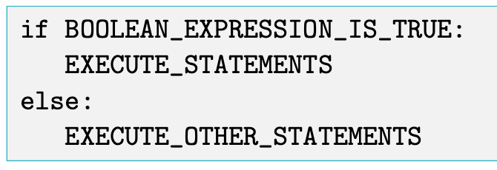
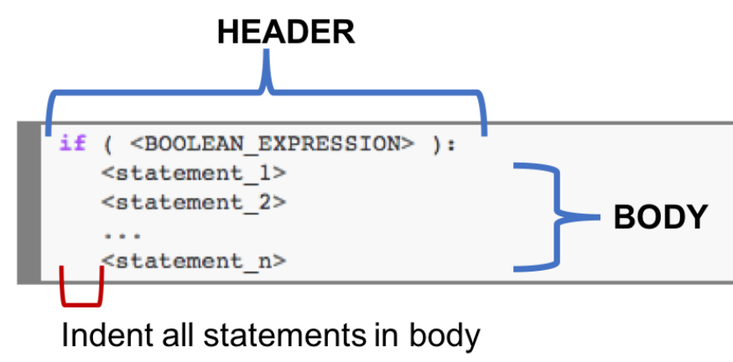
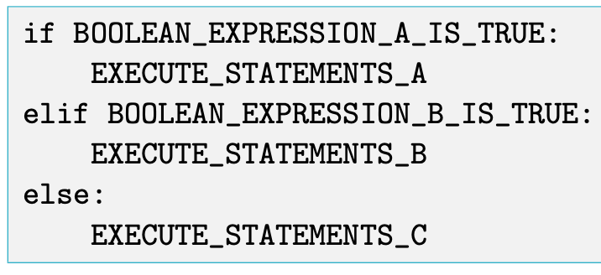
Python’s Implementation of Selection: IF
A header in Python is a specific keyword followed by a colon.
In the example, the if-else statement contains two headers, “if which == 'F':” containing keyword if, and “else:” consisting only of the keyword else.
Headers that are part of the same compound statement must be indented the same amount—otherwise, a syntax error will result.
Compound Statement

Slide 24
Indentation in Python
One fairly unique aspect of Python is that the amount of indentation of each program line is significant
In most programming languages, indentation has no effect on program logic
  It is simply used to align program lines to aid readability
In Python, however, indentation is used to associate and group statements

Slide 25
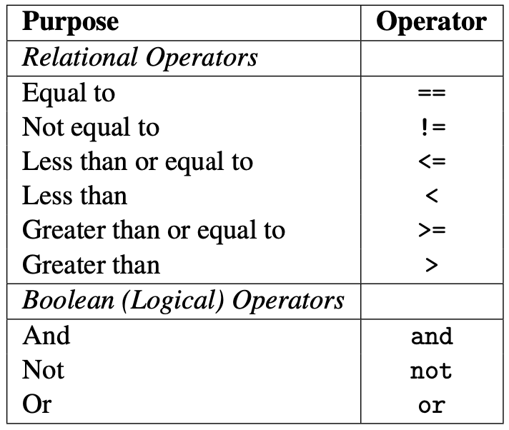
Boolean and Relational Operators
In Python:

Slide 26
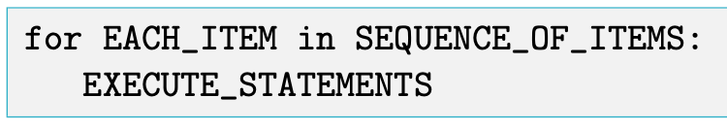
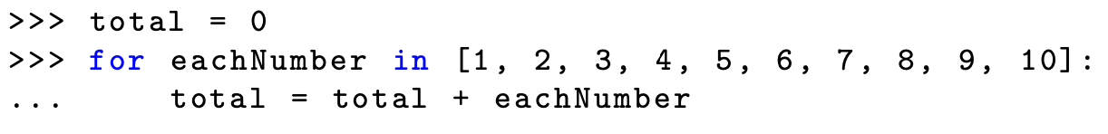
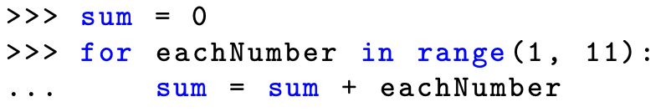
Python’s Implementation of Iteration: FOR
Python’s for statement provides a convenient means of iterating over lists (and other sequences)
A for statement is an iterative control statement that iterates once for each element in a specified sequence of elements
For loops are used to construct definite loops
  eachNumber is referred to as a loop variable

Slide 27
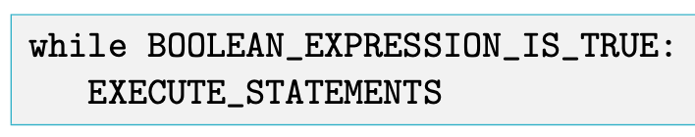
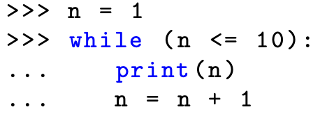
Python’s Implementation of Iteration: WHILE
Indefinite loops, where the number of times the loop is executed isn’t specified explicitly in advance, are implemented as while loops in Python
In the while loop version, loop variable n must be initialized and incremented each time through the loop
In the for loop version, however, loop variable eachNumber automatically iterates over the provided sequence of values

