Slide 1
Essential computational thinking: Chapter 07
Dr. Ricky J. Sethi
Essential Computational Thinking

Slide 2
Chapter 7
Procedural Programming

Slide 3
Story so far…
Data Representation + Algorithms = Computational Solutions
Algorithms can be made of three control structures:
Sequence
Selection
Iteration
Use these to solve any computable function!

Slide 4
Engineer this!
We can often solve the same problem in multiple ways
Suppose we want to move a chair:
We could run a few laps around campus before actually moving it
Or we could just directly move it
One approach is certainly more efficient than another
Engineering ideas applied to Software Development → Software Engineering!
Done by people like Margaret Hamilton at NASA

Slide 5
Abstraction!
One way to make solutions more efficient is to increase the level of abstraction
E.g., in the moving chair example, if the room has projectors, windows, etc., we can simply ignore them
But we would likely keep track of the tables and chairs as they might get in your way!

Slide 6
Sub-routines, Procedures, and Functions
We can increase the abstraction in our programmatic solutions, as well!
We can package our code into manageable pieces to make it more general
We can use sub-routines or procedures or functions!
Technically not synonyms as we’ll see in a bit!

Slide 7
Up to now…
So far, we have mainly seen only the most fundamental elements of Python: values, variables, and control structures
We often combined them into expressions and statements and used additional data structures like lists; we also used built-in commands or functions like input() and print()
In theory, these are the only instructions needed to write any program
From a practical point-of-view, however, these instructions alone are not enough
The problem is one of complexity; e.g., some applications contain over 10 million lines of code

Slide 8
Sub-routines
Dividing a program into manageable pieces is a way to manage complexity
These manageable pieces are called sub-routines
This is another form of abstraction since it gives us a more general, less detailed view of a system
A sub-routine is essentially a named group of instructions for performing some task
Sub-routines can be invoked (called) as many times as needed in a given program
Sub-routines provide the opportunity for code reuse
Sub-routines are fundamental building blocks in software construction since parts of the system do not have to be created from scratch as sub-routines can be re-used

Slide 9
Making lunches!
E.g., my kid likes to have PB&J for lunch every day!
Lunch has varying elements (carrots, cookies, etc.) but always PB&J
I know I have to do that process or routine every day!
Every time I make lunch, some parts of the process vary
But when it’s time for PB&J, I know exactly how that procedure goes

Slide 10
Same with Python!
I can define a procedure, or function, to make the sandwich: def makePBJ(PB, Jelly, Bread): Put PB on Bread Put Jelly on Bread Cut into squares
Now I can make lunch like this one day: Get carrots makePBJ(Skippy, Farms, Wonder)
And on another day: Get cookies makePBJ(Skippy, Farms, Wonder)

Slide 11
Morning has broken…
We Imagine you have a set routine every morning: you wake up, curse the alarm clock, and stumble out of bed, directly en route to the kitchen
You grab the nearest can of coffee grounds, boil some water, add the coffee grounds, and guzzle the resulting caffeine-induced nectar before finally waking up enough to realize it’s Sunday and you didn’t need to be awake at this ungodly hour anyway
We can illustrate this daily routine below:

Slide 12
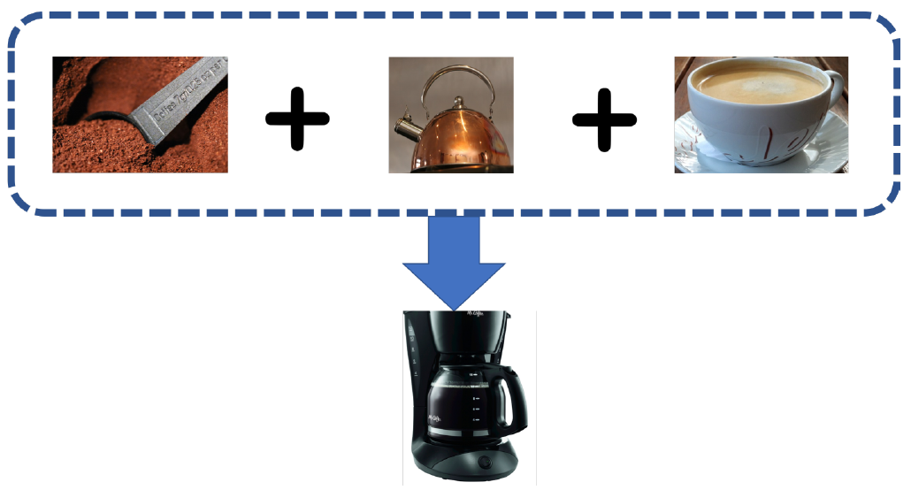
Functionalize!
A single entity that encapsulates a number of steps is referred to as a subroutine or procedure or function in computer science
In this context, you can think of a function as just a name for a particular sequence of instructions
For example, we might refer to the sequence of steps in our daily routine as CoffeeMaker
This is a kind of abstraction and, once you’ve defined a CoffeeMaker function, you can just use the name CoffeeMaker everywhere you’d normally utilize that entire sequence of instructions just as you do when making some coffee in your morning routine
A function in computer science is slightly different from a function as defined in mathematics
We’ve seen before that a mathematical function can be thought of as some process that takes an input and maps it to an output.

Slide 13
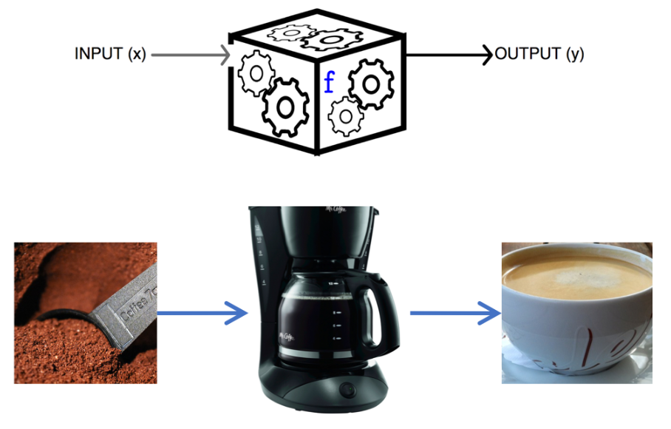
Sub-routines, Procedures, and Functions, oh my!
In imperative languages:
A sub-routine is a (usually named) sequence of instructions to perform some task that is encapsulated as a single unit
A procedure is a sub-routine that can possibly take some input, can have a side-effect, but does not return a value as output
A side-effect in computer science means anything that changes something, like changing a variable’s value, writing to a file, reading from a file, sending data to a display, etc.
A function is a procedure that does return a value, where the output value returned can be different on different calls to that function
There are subtle distinctions that can sometimes be drawn: e.g., you might have a pure function which always returns the same value on all calls for some specific input and does not produce any side-effects

Slide 14
Functions in general
Notice we start off by first defining the function and then, when the program itself starts, we can call, or invoke, the function as many times as we want
We also follow the functional notation from algebra and use parentheses after its name (CoffeeMaker()) to denote a function or procedure, with the input listed within the parentheses: CoffeeMaker(COFFEE_GROUNDS)
The input is referred to as the function’s parameter
We can further draw a distinction between the parameters in the function’s definition (called formal parameters) vs the parameters that are passed to the function when it’s called or invoked (these parameters are called the actual parameters or the arguments)

Slide 15
Functions in Python
In Python, things work the same way
We first define the procedure or function, using the Python keyword def
We can then call, or invoke, the procedure as many times as we wanted using functional notation, by using parentheses after the name of the procedure: print_the_chorus()

Slide 16
Story so far…
Functions are an initial attempt at modularization
There is a trend of increasing abstraction in higher and higher levels of programming
E.g., OOP is also this kind of modularization/abstraction

Slide 17
Basics
Python already understands some keywords or commands
print() went from being a statement (in Python 2.x) to being a function (Python 3.x)
It also understands values like numbers, strings, etc.
And it uses Functional Notation, just like in Algebra

Slide 18
Functions are also just like in Algebra
A function has a name (identifier) and arguments or parameters:
y = f(x)
Assignment Operator
Variable
Function name: f
Function argument/parameter: x

Slide 19
Defining Functions
A function header starts with the keyword def, followed by an identifier (like print), which is the function’s name
The function name is followed by a comma-separated, possibly empty, list of variable identifiers called formal parameters, or simply “parameters”, within parentheses ,(), followed by a colon ( : )
Following the function header is the function body, a program block containing the function’s imperative statements
As with all blocks in Python, the statements must be indented at the same level, relative to the function header
def f(z):
return z*z
x=5
y=f(x)
print(y)

Slide 20
Function Invocation
Every function must be defined before it is used, or called, or invoked
Functions are generally defined at the top of a program
The actual values passed to the function are called actual parameters, or arguments

Slide 21
Value-Returning Functions
A value-returning function is a function that’s called for its return value, just like a mathematical function:
f(x) = x*x
In this notation, “x” stands for any numeric value that function f() may be applied to
f(2) = 2 x 2 = 4
Value-returning functions in Python are similarly used
Their call, or invocation, is replaced with their final value

Slide 22
Value-Returning Functions
A value-returning function is a sub-routine called for its return value, and is therefore similar to a mathematical function, e.g.,
y = f(x) = x*x → DEFINITION
In this notation, “x” stands for any numeric value that function f may be applied to,
y = f(2) = 2 x 2 = 4 → INVOCATION/CALL
y = f(4) = 16
Functions in Python are similarly used: Symbol Table on next slide to keep track of them!

Slide 23
Symbol Table
X = f(1)
X = f(10)
Symbol Table Below
Variable Name | Value
N1 | 1
N2 | 4
N3 | 10
X | 1
X | 100

Slide 24
Function Composition
You can use function composition just as in mathematics:
So you can have calls like: print( format(value, format_specifier_string) )
f
g
f

Slide 25
Video
Video on Socratica: Python Functions: https://www.youtube.com/watch?v=NE97ylAnrz4
Functions in CS are just like in math: functional notation
In the beginning, are they using a shell/interpreter or a program/file?
Function Definition vs Function Invocation/Call/Execution

Slide 26
Parameters/Arguments
Formal parameters vs Actual parameters/Arguments
Values are passed FROM arguments TO formal parameters, which are just local variables
Function Signatures: no default arguments in most other languages and they use the Data Type of the formal parameters in the function signature
KeyWord Arguments == Default Arguments are the named arguments and must have a name=value part in formal and actual invocation

Slide 27
Exceptions
Video on Let's learn Python: Exceptions: https://www.youtube.com/watch?v=hrR0WrQMhSs

