Slide 1
Essential computational thinking: Chapter 08
Dr. Ricky J. Sethi
Essential Computational Thinking

Slide 2
Chapter 8
Object-Oriented Programming (OOP)

Slide 3
The story so far…
We’ve already seen how we might create a class blueprint and use that class to create objects
The class blueprint is the Class Data Type
We can then use those objects to send messages, either to other objects or even to itself
Sending a message, in the OOP way of thinking, means calling, or invoking, some action or service that’s defined for that module or class

Slide 4
Classes and Objects Revisited
The programs we’ve written in previous examples have used pre-defined classes in the standard Java Class Library (JCL from the Java API)
Now we will begin to design programs that rely on classes that we write ourselves
The Class Data Type we define is thus a User-defined Data Type
The class that contains the main() method is just the starting point of an application program, usually a driver program
True object-oriented programming is based on defining classes that represent objects with well-defined characteristics and functionality

Slide 5
Regular Variables vs Object Reference Variables
Normal variables are declared as: int x = 0;
A variable is a symbol or name or identifier for some address in memory
We can also declare object reference variables
Object reference variables are names for some address in memory where the object itself lives
Variables on Steroids: Variables with abilities far beyond those of mortal variables…
String foo = new String(“Hello”);
Object reference variables let you access the actual object
Object itself has both attributes and behaviours!

Slide 6
Objects and Classes
Name/TYPE
only main() for most of our classes/programs so far
Attributes/FIELDS
Behaviour/METHODS
Class Data Types have:
Name/TYPE
Attributes/FIELDS
Characteristics, State, etc. Called Instance Variables/Fields
Behaviour/METHODS
Services, Abilities, etc. Called Methods
Those behaviours are defined by a BLUEPRINT, the CLASS DEFINITION
Just like you have a blueprint for a house
The blueprint can be expressed in a UML notation, as seen above

Slide 7
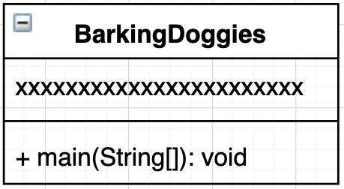
Kinds of Applications We’ve Built So Far…
Problem: a dog that barks: build a class to solve it!
Simple Main Class: BarkingDoggies.java
More General Application: BarkingDoggies.java
Variables allow flexibility and reliability
public class BarkingDoggies {
public static void main(String[] args) {
System.out.println(“Woof!”);
}
}
class BarkingDoggies {
public static void main(String[] args) {
String barkSound = new String(“Woof!”);
System.out.println( barkSound );
}
}

Slide 8
OOP WAY: Driver and Helper Class based App – Ver 1 (no Attributes)
Problem: a dog that barks
Driver Class Application: BarkingDoggies.java
Helper Class: Dog.java
class BarkingDoggies {
public static void main(String[] args) {
Dog spot = new Dog();
spot.bark();
}
}
public class Dog { public void bark() {
System.out.println(“Woof!”);
}
}

Slide 9
Small Driver and Helper Class based Application – Ver 2 (with Attribute/Field)
Problem: a dog that barks
Driver Class Application: BarkingDoggies.java
Helper Class: Dog.java
class BarkingDoggies {
public static void main(String[] args) {
Dog spot = new Dog();
spot.bark();
}
}
public class Dog {
String barkSound = new String("Woof!");
public void bark() {
System.out.println(barkSound);
}
}

Slide 10
Customized Construction…
We can create more doggies in BarkingDoggies.java, as such:
But all the Doggies currently just say “Woof!”
What if we want to have Spot say “Woof!” but Fido to say “Arf! Arf!”?
Define a custom Constructor Method to customize the barkSound!
class BarkingDoggies {
public static void main(String[] args) {
Dog spot = new Dog();
spot.bark();
Dog fido = new Dog();
fido.bark();
}
}

Slide 11
Solving Problems with OOP
Using Software Objects

Slide 12
Solving Problems with Software Objects
How do we use classes and objects to actually solve computational problems?
The process of creating computational solutions in an Object-Oriented paradigm involves:
1. Define the class
2. Use the class to create one or more objects
3. Have the objects send messages to each other and do stuff!
Doing stuff often involves changing the data variables, or properties, of these objects
The message invoked is the method, or function

Slide 13
A Detailed Example
How exactly does this kind of message passing eventually lead to a solution?
Let’s examine a detailed example of setting up and using a bank account
We’ll write a program that allows a user to open an account and simply deposit money into that account

Slide 14
Start with Requirements and Specifications
The requirements statement: Create new bank accounts, allow deposits of money into the accounts, and display the new balance.
We can now bold the relevant nouns and underline the verbs
Most nouns will likely become either objects themselves or properties (data variables) of those objects in our new program Most verbs will likely become the actions, or functions (methods)
Now the specifications: Create new bank accounts, allow deposits of money into the accounts, and display the new balance.

Slide 15
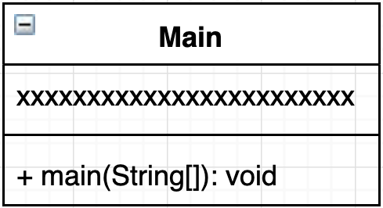
Start with a simple main() method
We start with a simple Application for Hello World
Make a UML diagram for it
This is a DRIVER Class Application and we keep the main() as simple as possible to get things going:
class Main {
public static void main(String[] args) {
System.out.println(”Hello World!");
}
}

Slide 16
Add in some variable declarations
Let’s work on a Bank Account problem
Start by creating a primitive variable
Next create a variable on steroids (object reference variable) to track Bank Accounts for multiple people like John/Pat/Mindy
class Main {
public static void main(String[] args) {
int x = 0; // Doesn’t do anything!
// Create an object reference VARIABLE *only*
Account johnsAccount;
}
}

Slide 17
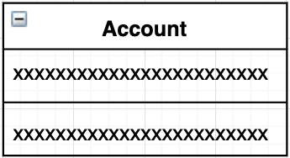
We need an Account Class or TYPE
Compiler doesn’t know Account data type by default
Need a user-defined data type: Class Data Type!
Let’s outline the Account Class UML
class Main {
public static void main(String[] args) {
int x;
x = 5;
// Create an object reference VARIABLE
Account johnsAccount;
// Create the new OBJECT in memory now
johnsAccount = new Account();
}
}
class Account {
}

Slide 18
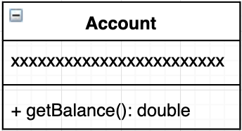
Let’s add in a Service/Method/Behaviour
Our Account object reference VARIABLE hasn’t taken enough steroids → doesn’t do anything yet!
Let’s add in the ability to return the current balance
Use the DOT OPERATOR
class Main {
public static void main(String[] args) {
// Create an object reference VARIABLE and INITIALIZE object
Account johnsAccount = new Account();
System.out.println("Balance for John: "+ johnsAccount.getBalance());
}
}
class Account { // --------------------------------------------
// Returns balance amount
// --------------------------------------------
public double getBalance() {
return 50;
}
}

Slide 19
We can use the Class Data Type to create Multiple Objects
Let’s create multiple bank account objects now!
OOPS! They both have the same balance!
class Main {
public static void main(String[] args) {
// Create an object reference VARIABLE and INITIALIZE object
Account johnsAccount = new Account();
System.out.println("Balance for John: "+ johnsAccount.getBalance());
// Create ANOTHER object reference VARIABLE and INITIALIZE object
Account patsAccount = new Account();
System.out.println("Balance for Pat: "+ patsAccount.getBalance());
}
}
class Account { // --------------------------------------------
// Returns balance amount
// --------------------------------------------
public double getBalance() {
return 50;
}
}

Slide 20
Extend the Class Data Type Functionality
First, we define the Class Data Type:
// DEFINE CLASS Account:
class Account {
// Hidden Data Structure
private double balance;
// PUBLIC Method
public void getBalance() {
System.out.println("Balance is: $"+ balance);
}
// PUBLIC Method
public void makeDeposit(double depositAmount) {
System.out.println(" --> Depositing $"+ depositAmount);
balance = balance + depositAmount;
}
}

Slide 21
Now the main program/driver class…
The main driver application:
// MAIN Program Here:
public class Main {
public static void main(String[] args) {
// Create a new Account object called joeAccount
Account joeAccount = new Account();
// Check balance in Joe's Account & make some deposits
joeAccount.printBalance();
joeAccount.makeDeposit(30);
joeAccount.printBalance();
joeAccount.makeDeposit(100);
joeAccount.printBalance();
}
}

Slide 22
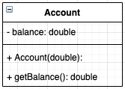
Add a Constructor to initialize objects
A Constructor is like the Contractor a Builder might hire
The Class Data Type DEFINITION is like a BLUEPRINT
Object-specific DATA is stored in FIELDS/INSTANCE VARIABLES
This DATA determines the STATE of the OBJECT
The Constructor initializes these FIELDS/INSTANCE VARIABLES
Declared INSIDE a Class Definition but OUTSIDE any Method Definition
class Main {
public static void main(String[] args) {
Account johnsAccount = new Account(50);
System.out.println("Balance for John: "+ johnsAccount.getBalance());
Account patsAccount = new Account(50000);
System.out.println("Balance for Pat: "+ patsAccount.getBalance());
}
}
class Account {
private double balance;
public Account(double initialBalance) {
balance = initialBalance;
}
public double getBalance() {
return balance;
}
}
Difference between LOCAL variables and INSTANCE variables

Slide 23
Primitive vs Object Variables
Java consists of both primitive variables, like x, as well as object variables, like joeAccount
Object variables are like “variables on steroids”:
They can both hold values and you can also pass messages to them
Instead of a single item (the value) used to instantiate a primitive variable, instantiating an object variable requires three items:
The new operator to start the process of building a new object
The name of the class blueprint used to build the object
Optional value(s) to initialize the object

Slide 24
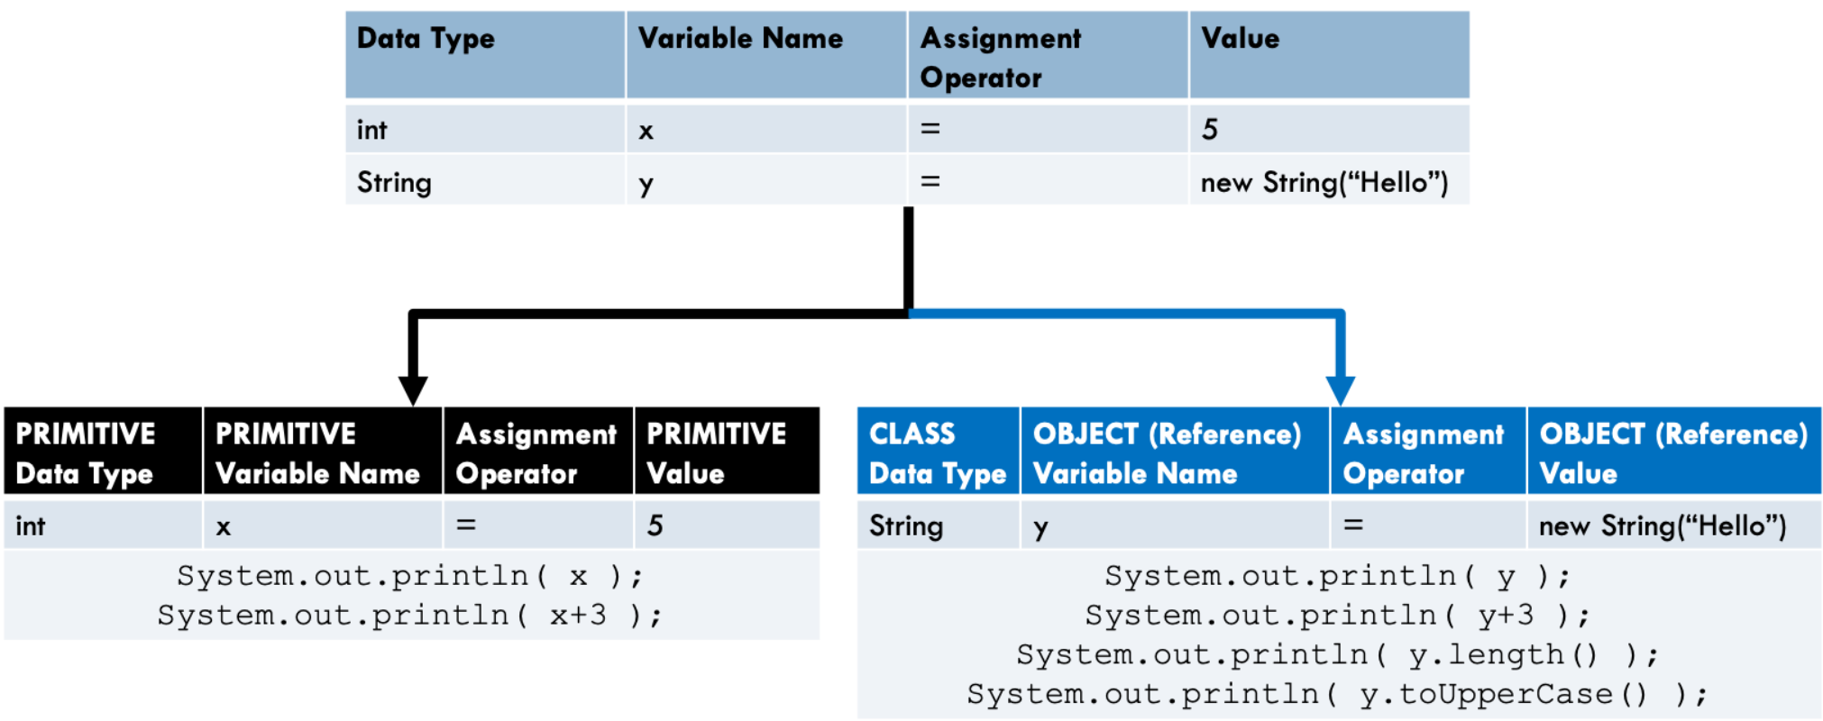
Object Reference Variables
Object Reference Variable vs Primitive Variable

Slide 25
Object-Oriented Design
OOD

Slide 26
Identifying Classes and Objects
The main task of object-oriented design is determining the classes and objects that will constitute the computational solution
The classes may be part of a class library, reused from a previous project, or newly written
One way to identify potential classes is to identify the objects mentioned in the requirements document
The objects usually correspond to the nouns in the requirements document and the methods or services that an object provides generally correspond to the verbs

Slide 27
Identifying Classes and Objects
Excerpt from a requirements (not specifications) document:
Nota Bene: all nouns/verbs will not correspond to a class/object/method in the final computational solution
But most Nouns will usually correspond to objects/classes or attributes and most Verbs will usually correspond to methods
The user must be allowed to specify each product by
its primary characteristics, including its name and
product number. If the bar code does not match the
product, then an error should be generated to the
message window and entered into the error log. The
summary report of all transactions must be structured
as specified in section 7.A.

Slide 28
Identifying Classes and Objects
Remember that a class represents a group (or category or classification) of objects with the same behaviors
Generally, classes that represent objects and should be given names that are singular nouns
For example, names like: Coin, Student, Message
A class represents the concept of one such object
We are free to instantiate as many objects of each class as we need in the computational solution

Slide 29
Identifying Classes and Responsibilities
Part of identifying the classes we need in a computational solution involves assigning responsibilities to each class
Every activity that a program will do has to be represented by one or more methods within a class
In the early stages of software development, we don’t have to decide every method of every class
Instead, we begin with the primary responsibilities and then evolve the design in an iterative fashion

