Slide 1
Essential computational thinking: Chapter 10
Dr. Ricky J. Sethi
Essential Computational Thinking

Slide 2
Chapter10
Machine Learning

Slide 3
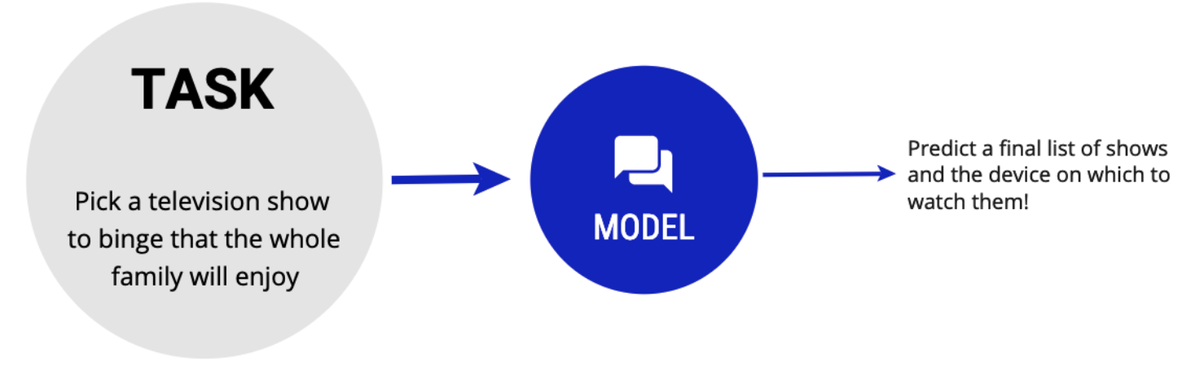
Example – Movie Night Prediction
Task (T): Choosing a show for family movie night.
Experience (E): Past viewing history & preferences (e.g., wife likes Outlander).
Performance (P): Accuracy of predicting enjoyment.
My mental MODEL = a machine learning model:
  Input: DATA: shows + viewing platforms (Hulu, Netflix, etc.).
  Output: PREDICTION: likelihood of enjoyment.
  It’s a function!
Extended model: predicting preferences for the whole family.
DATA

Slide 4
Why Machine Learning?
We tend to learn new things by memorization and generalization.
We use memorization to accumulate individual facts and generalization to deduce new facts from old facts.
Hand-crafted rules are often too complex.
Machine learning extracts patterns from data to analyze new situations.
Tom Mitchell’s definition:
A computer program is said to learn from experience “E”, with respect to some class of tasks “T” and performance measure “P”, if its performance at tasks in “T” as measured by “P” improves with experience “E”
➔ Algorithms improve with experience (data).

Slide 5
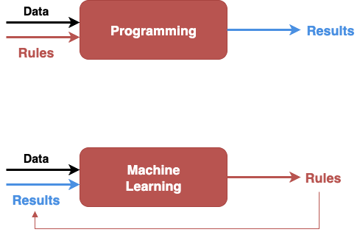
ML vs Traditional Programming
Inversion!

Slide 6
The Core ML Framework
Machine learning studies algorithms that:
  Improve their Performance (P)
  At some Task (T)
  With Experience (E)
Business problem defines Task (T).
Data type (labeled, unlabeled, etc.) and resources dictate choice of algorithm.
  Most ML problems = optimization.
    Exceptions: k-NN, Bayesian probability, etc.
Task (T)
Experience (E)
Performance (P)

Slide 7
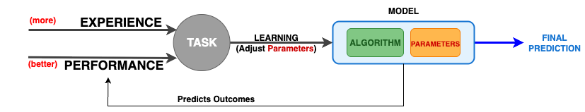
What is ML?
Machine learning is thus the study of algorithms/models that:
  improve their performance, P
  at some task, T
  with experience, E
Learning is guided by an objective/loss function: Minimize loss / maximize gain.
Optimization methods: Gradient Descent, Stochastic Gradient Descent.
Data
(Rules)
Results

Slide 8
Supervised Learning in a Nutshell
Purpose
Purpose: learn decision boundaries to assign labels to new samples.
Use
Use labeled data + features (e.g., ear size and whisker length for cats vs dogs).
Plot
Plot features (ear size vs whisker size) to visualize separability.
Algorithm searches for an optimal boundary by optimizing a chosen objective/score.

Slide 9
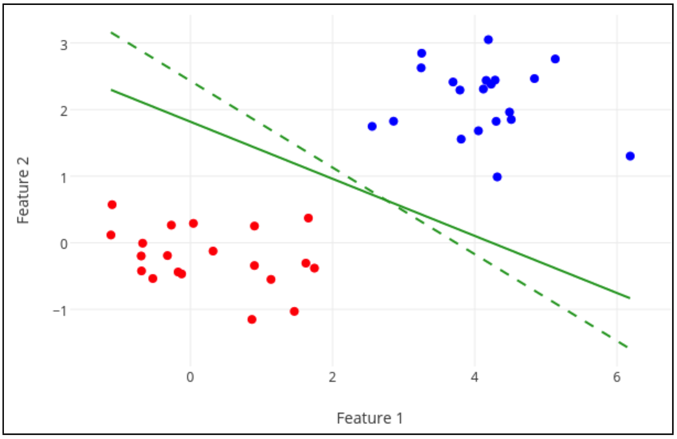
From Boundary to Model → Prediction
Boundary shape depends on the algorithm:
  Straight line/plane (linear models)
  Angled piecewise lines (decision trees)
  Curvy/nonlinear boundaries (neural nets, kernels)
After tuning parameters, the trained algorithm is the model.
To predict: place a new sample relative to the learned boundary.

Slide 10
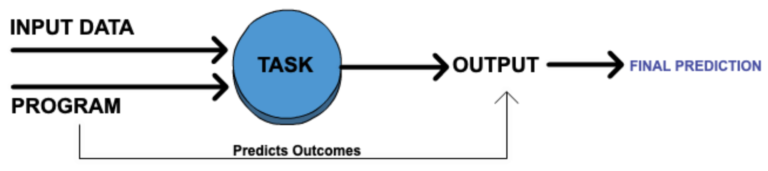
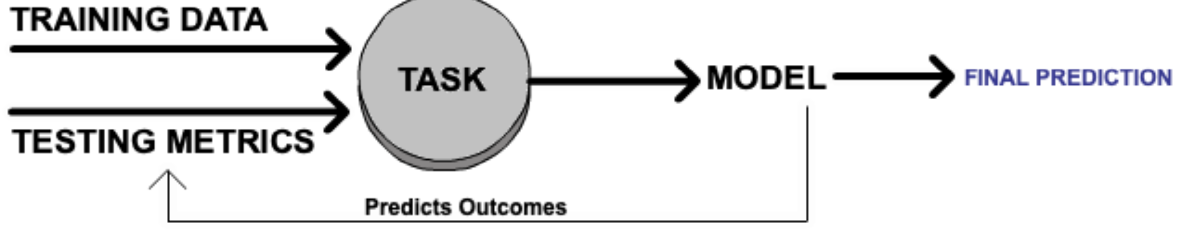
ML vs. Traditional Programming
Traditional
See Earlier slide
ML

Slide 11
PAUSE
PAUSE

Slide 12
Lecture Outline
1) Framing ML: P–T–E definition; Why ML
2) Elements: tasks, models, learning styles
3) Supervised learning: boundaries, workflow, splits
4) Evaluation: metrics, hypothesis tests, confusion tables
5) Entropy & decision trees (+ example)
6) Algorithms: ensembles, deep learning (context)
7) Data Science process & research questions
8) Addendum figures (2+ slides each): choosing algorithms, supervised dataflow, DS flowchart, ensembles, etc.
  Recap & discussion prompts
Notes:
Timing guide (~120 min):
- Sections 1–3 (35–40 min): Motivation, definition, supervised learning overview & workflow.
- Section 4 (20 min): Metrics, hypothesis testing, confusion tables/statistics.
- Section 5 (15–20 min): Entropy & decision trees with a worked example.
- Section 6 (10–15 min): Ensembles, deep learning context.
- Section 7 (10–15 min): DS process & research questions.
- Section 8 (20–25 min): Addendum figures walkthrough (2 slides each).
- Slack/Q&A sprinkled between sections (~10 min total).

Slide 13
What is ML? (Mitchell + Turing)
A program learns from Experience (E)
  - at Task(s) (T)
  - if its Performance (P) improves with E
Once performance is sufficient, output final prediction
Notes:
Explain Mitchell's definition (P/T/E) and intuition: memorization + generalization.
Use a simple example (cats vs. dogs) to connect data → model → prediction.
Emphasize the role of a performance measure and the notion of “sufficient” performance before deployment.
Tie to Figure 10.1 narrative from the chapter.

Slide 14
Why ML (vs. hand‑crafted rules)
Rules are brittle/hard to author for complex domains
ML extracts patterns from data and generalizes
Learning guided by an objective/loss function
Notes:
Position ML as practical necessity when rule enumeration explodes.
Call out that most training is framed as optimization of a loss (or reward in RL).
Segue to Elements of ML: tasks, models, metrics.

Slide 15
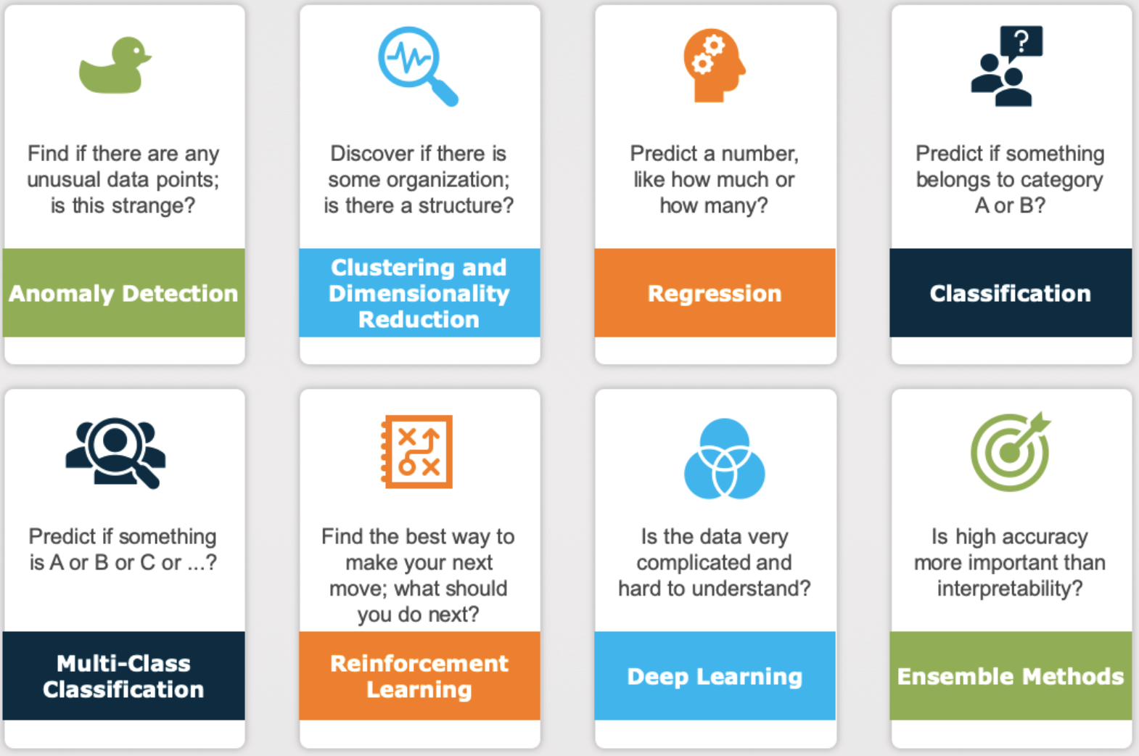
Elements of ML: Tasks (8 common questions)
Anomaly detection; Clustering/Dim. Reduction
Regression; Binary & Multi‑class classification
Reinforcement learning; Deep learning
Ensembles for accuracy/robustness
Notes:
Walk students through the “8 common tasks/questions” list and set expectations for where each appears in practice.
Note: often we also ask 'Is this the best?' → optimization framing.

Slide 16
Elements of ML: Models & Learning Styles
Categorize by learning style:
  - Supervised; Unsupervised; (Semi‑supervised)
Program structure emerges from data + desired output
Compare CS paradigm vs ML paradigm
Notes:
Clarify difference between traditional CS (write rules) vs ML (learn rules).
Introduce semi‑supervised and representation learning as context; main focus today remains classic supervised/unsupervised.

Slide 17
Supervised Learning in a Nutshell
Goal: learn boundary from labeled data
Boundary shape depends on algorithm
Model = trained algorithm + parameters
Notes:
Use ear‑size vs whisker‑length story (cats/dogs).
Reinforce: features → boundary; training finds parameters that optimize objective; prediction assigns labels via boundary side.

Slide 18
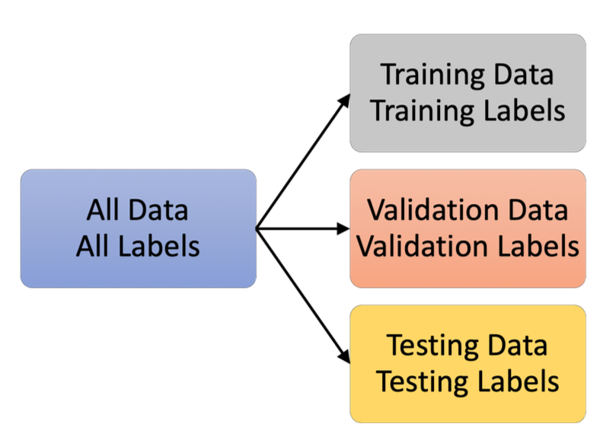
Workflow: Train/Validate/Test
Pick algorithm for task
Train on training set (fit parameters)
Tune on validation set (hyperparameters)
Hold‑out test for final estimate; then deploy
Notes:
Outline the disciplined split and why we don't touch the test set until the end.
Mention cross‑validation for small datasets; discuss leakage pitfalls.

Slide 19
Evaluation & Hypothesis Testing (preview)
Hypothesis tests, z‑tests; probability trees (intuition)
Match metrics to task & class balance
Notes:
Connect statistical inference and ML evaluation.
Set up confusion tables/statistics next; emphasize alignment of metric to business costs.

Slide 20
Confusion Tables & Statistics
TP, TN, FP, FN → Accuracy, Precision, Recall, F1
Specificity/Sensitivity; PPV/NPV; TPR/FPR
Notes:
Define the cells and derive common metrics; show how precision/recall trade off.
Discuss significance (α) and power (1−β) in testing contexts, and how imbalanced data misleads accuracy.

Slide 21
Entropy & Information Gain → Decision Trees
Shannon info & entropy (uncertainty)
Information gain drives tree splits
Notes:
Give intuition for entropy as average surprise; lower entropy = purer nodes.
Walk through how info gain (Δentropy) selects splits; tee up a worked example.

Slide 22
Decision Tree Example (with entropies)
Compute parent entropy
Evaluate candidate splits → weighted child entropies
Pick max information gain
Notes:
Do a small numeric example at the board or on a worksheet.
Discuss overfitting, depth control, min samples per leaf; segue to ensembles.

Slide 23
Ensembles (Bagging, Boosting, Stacking)
Bagging: variance reduction via bootstrap
Boosting: sequential focus on hard cases
Stacking: meta‑learner blends diverse models
Notes:
Explain when/why to use each; highlight Random Forest as default strong baseline.
Note: interpretability vs accuracy trade‑offs.

Slide 24
Data Science Process & Research Questions
EDA → precise, falsifiable questions
Map business problem → ML task
Draft variables: predictors vs response
Notes:
Use the “genie” and drafting‑questions idea to move from vague to testable.
Tie back to the 8 common ML approaches; choose metrics up‑front to avoid moving goal‑posts.

Slide 25
Figure: Selecting a ML Algorithm (flowchart) — Concepts
Heuristic flow for choosing algorithms
Consider data type/size, labels, interpretability, accuracy needs
Notes:
Use this slide to summarize the figure's key ideas in words.
Then switch to the next slide for a step‑by‑step walkthrough.
Instructor notes:
Walk the flowchart top‑to‑bottom with a case: tabular churn vs. image classification.
Emphasize constraints-first: start simple, get a baseline, then relax constraints.

Slide 26
Figure: Selecting a ML Algorithm (flowchart) — Instructor Walkthrough
Walk through the figure left→right or top→bottom
Call out assumptions, caveats, and practical tips
Provide a quick applied example
Notes:
Suggested flow:
1) Orient students to the axes/boxes/arrows in the figure.
2) Relate each branch/box to a concrete scenario.
3) End with 'what could go wrong?' discussion.
Walk the flowchart top‑to‑bottom with a case: tabular churn vs. image classification.
Emphasize constraints-first: start simple, get a baseline, then relax constraints.

Slide 27
Figure: General Supervised Learning Model — Concepts
Train→Validate→Test→Predict pipeline
Parameters vs hyperparameters
Notes:
Use this slide to summarize the figure's key ideas in words.
Then switch to the next slide for a step‑by‑step walkthrough.
Instructor notes:
Clarify parameter vs. hyperparameter; show where feature engineering lives.
Note leakage risks (fit transforms only on training).

Slide 28
Figure: General Supervised Learning Model — Instructor Walkthrough
Walk through the figure left→right or top→bottom
Call out assumptions, caveats, and practical tips
Provide a quick applied example
Notes:
Suggested flow:
1) Orient students to the axes/boxes/arrows in the figure.
2) Relate each branch/box to a concrete scenario.
3) End with 'what could go wrong?' discussion.
Clarify parameter vs. hyperparameter; show where feature engineering lives.
Note leakage risks (fit transforms only on training).

Slide 29
Figure: Supervised Learning Dataflow Overview — Concepts
Wrangle/clean → split → engineer/tune → evaluate → finalize
Notes:
Use this slide to summarize the figure's key ideas in words.
Then switch to the next slide for a step‑by‑step walkthrough.
Instructor notes:
Discuss normalization, missing data handling, and cross‑validation.
Show how the same cleaning must apply to new/unseen data.

Slide 30
Figure: Supervised Learning Dataflow Overview — Instructor Walkthrough
Walk through the figure left→right or top→bottom
Call out assumptions, caveats, and practical tips
Provide a quick applied example
Notes:
Suggested flow:
1) Orient students to the axes/boxes/arrows in the figure.
2) Relate each branch/box to a concrete scenario.
3) End with 'what could go wrong?' discussion.
Discuss normalization, missing data handling, and cross‑validation.
Show how the same cleaning must apply to new/unseen data.

Slide 31
Figure: Data Science Flowchart — Concepts
Exploratory vs Predictive vs Inferential
When to use ML vs statistical inference
Notes:
Use this slide to summarize the figure's key ideas in words.
Then switch to the next slide for a step‑by‑step walkthrough.
Instructor notes:
Interactive prompt: classify 3 example questions (EDA, predictive, inferential).
Discuss high‑dimensional cues for ML vs low‑dimensional inference.

Slide 32
Figure: Data Science Flowchart — Instructor Walkthrough
Walk through the figure left→right or top→bottom
Call out assumptions, caveats, and practical tips
Provide a quick applied example
Notes:
Suggested flow:
1) Orient students to the axes/boxes/arrows in the figure.
2) Relate each branch/box to a concrete scenario.
3) End with 'what could go wrong?' discussion.
Interactive prompt: classify 3 example questions (EDA, predictive, inferential).
Discuss high‑dimensional cues for ML vs low‑dimensional inference.

Slide 33
Figure: Data Science Process — Concepts
1) Question 2) Gather 3) Understand 4) Predict 5) Communicate
Notes:
Use this slide to summarize the figure's key ideas in words.
Then switch to the next slide for a step‑by‑step walkthrough.
Instructor notes:
Stress iteration and storytelling with metrics.
Have students draft a research question from a mini‑dataset description.

Slide 34
Figure: Data Science Process — Instructor Walkthrough
Walk through the figure left→right or top→bottom
Call out assumptions, caveats, and practical tips
Provide a quick applied example
Notes:
Suggested flow:
1) Orient students to the axes/boxes/arrows in the figure.
2) Relate each branch/box to a concrete scenario.
3) End with 'what could go wrong?' discussion.
Stress iteration and storytelling with metrics.
Have students draft a research question from a mini‑dataset description.

Slide 35
Figure: Eight Common ML Approaches — Concepts
Anomaly, Clustering/DR, Regression, (Binary/Multi) Classification, RL, DL, Ensembles
Notes:
Use this slide to summarize the figure's key ideas in words.
Then switch to the next slide for a step‑by‑step walkthrough.
Instructor notes:
Map each to a 1‑sentence real‑world example; ask the class to propose one each.
Note the 'Is this the best?' optimization add‑on.

Slide 36
Figure: Eight Common ML Approaches — Instructor Walkthrough
Walk through the figure left→right or top→bottom
Call out assumptions, caveats, and practical tips
Provide a quick applied example
Notes:
Suggested flow:
1) Orient students to the axes/boxes/arrows in the figure.
2) Relate each branch/box to a concrete scenario.
3) End with 'what could go wrong?' discussion.
Map each to a 1‑sentence real‑world example; ask the class to propose one each.
Note the 'Is this the best?' optimization add‑on.

Slide 37
Figure: Drafting ML Research Questions — Concepts
Business problem → initial statement → final (task‑aligned) question
Notes:
Use this slide to summarize the figure's key ideas in words.
Then switch to the next slide for a step‑by‑step walkthrough.
Instructor notes:
Use the employee‑churn example; convert to classification vs regression forms.
Check predictor/response identification; define success metric.

Slide 38
Figure: Drafting ML Research Questions — Instructor Walkthrough
Walk through the figure left→right or top→bottom
Call out assumptions, caveats, and practical tips
Provide a quick applied example
Notes:
Suggested flow:
1) Orient students to the axes/boxes/arrows in the figure.
2) Relate each branch/box to a concrete scenario.
3) End with 'what could go wrong?' discussion.
Use the employee‑churn example; convert to classification vs regression forms.
Check predictor/response identification; define success metric.

Slide 39
Figure: Confusion Table Statistics — Concepts
From counts to metrics: Precision, Recall, F1, ROC/PR intuition
Notes:
Use this slide to summarize the figure's key ideas in words.
Then switch to the next slide for a step‑by‑step walkthrough.
Instructor notes:
Small exercise: given TP/TN/FP/FN, compute precision/recall and discuss trade‑offs.
Note PPV/NPV when prevalence shifts.

Slide 40
Figure: Confusion Table Statistics — Instructor Walkthrough
Walk through the figure left→right or top→bottom
Call out assumptions, caveats, and practical tips
Provide a quick applied example
Notes:
Suggested flow:
1) Orient students to the axes/boxes/arrows in the figure.
2) Relate each branch/box to a concrete scenario.
3) End with 'what could go wrong?' discussion.
Small exercise: given TP/TN/FP/FN, compute precision/recall and discuss trade‑offs.
Note PPV/NPV when prevalence shifts.

Slide 41
Figure: Ensemble Methods (Stack/Bag/Boost) — Concepts
Parallel vs sequential; variance vs bias handling
Notes:
Use this slide to summarize the figure's key ideas in words.
Then switch to the next slide for a step‑by‑step walkthrough.
Instructor notes:
Run through RF vs GBM trade‑offs; mention early stopping & regularization in boosting.
Share rules of thumb for tabular data.

Slide 42
Figure: Ensemble Methods (Stack/Bag/Boost) — Instructor Walkthrough
Walk through the figure left→right or top→bottom
Call out assumptions, caveats, and practical tips
Provide a quick applied example
Notes:
Suggested flow:
1) Orient students to the axes/boxes/arrows in the figure.
2) Relate each branch/box to a concrete scenario.
3) End with 'what could go wrong?' discussion.
Run through RF vs GBM trade‑offs; mention early stopping & regularization in boosting.
Share rules of thumb for tabular data.

Slide 43
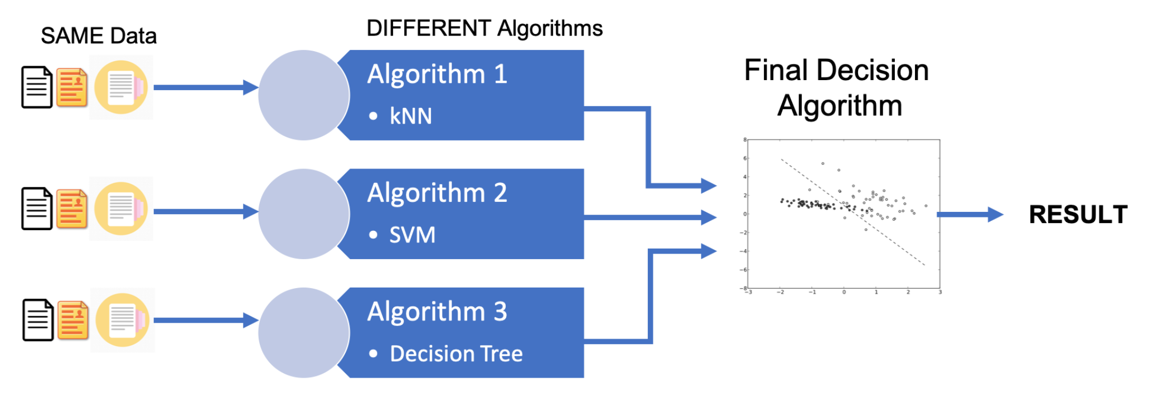
Ensemble Method: Stacking
Stacking, as seen in Figure 10.6, feeds the same original data to several different algorithms and the output of each of those intermediate algorithms is passed to a final algorithm which makes the final decision.

Slide 44
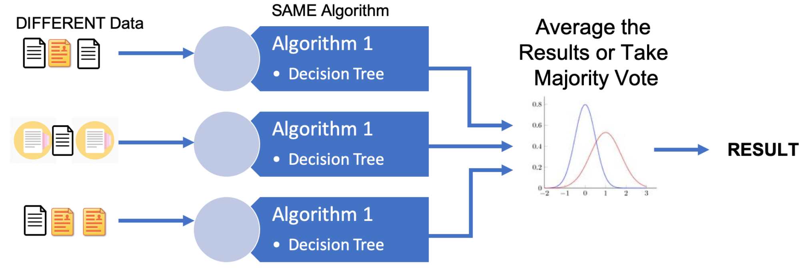
Ensemble Method: Bagging
Bootstrap AGGregatING (Bagging) uses the same algorithm on several different subsets of the original data that are produced by bootstrapping, random sampling with replacement from the original data. The result of each component is then averaged in the end, as seen in Figure 10.7. The random forests we saw before used Bagging on Decision Trees.

Slide 45
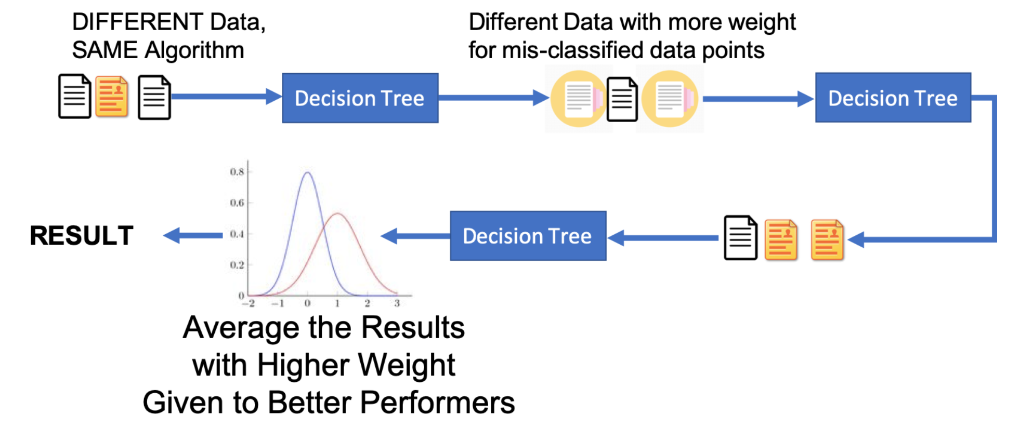
Ensemble Method: Boosting
Boosting uses several different algorithms in a linear, sequential way rather than in a parallel way as in Bagging.
Similar to Bagging, though, each subsequent algorithm is fed a subset of the original data that is produced by random sampling with replacement from the original data but, different from Bagging, the mis-classified data in the previous step is weighted more heavily in a subsequent step.
As a result, the different algorithms are trained sequentially with each subsequent algorithm concentrating on data points that were mis-classified by the previous algorithm

Slide 46
Recap & Discussion
Define ML via P–T–E; supervised vs unsupervised; workflow & evaluation
Entropy/trees; ensembles; DS process; research questions
What would you change when data drifts? How do you pick metrics?
Notes:
Ask 3 cold‑call questions:
- Given a noisy, imbalanced dataset, which metrics would you report first and why?
- How would you test for overfitting without a separate test set?
- If your model underperforms in production, what steps do you take next?
Wrap with next‑class preview (hands‑on lab).

Slide 47
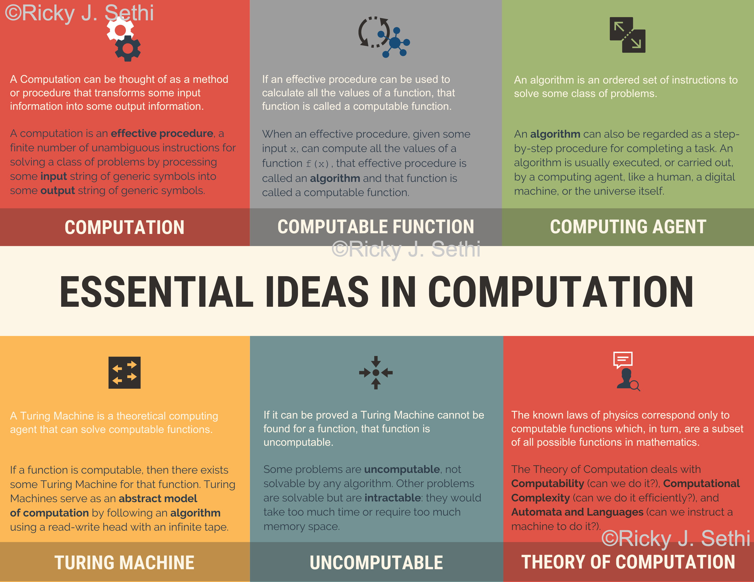
Addendum Figure 1 (from page 1)
Notes:
This is an extracted figure from the addendum (page 1).
Speaker notes:
- Orient students to the figure’s structure (axes, boxes, arrows, legends).
- Explain how to interpret each component and how it links to the main chapter.
- Highlight assumptions, limitations, and common pitfalls.
- Invite students to identify a real scenario where this figure applies.

Slide 48
Addendum Figure 1 — Walkthrough & Discussion
Step‑by‑step walkthrough of the figure
  - Define the problem context the figure addresses
  - Explain each part of the diagram and the data flow
  - Relate to model selection/evaluation choices
Key takeaways and caveats
Notes:
Instructor walkthrough:
1) Start from the top/left and trace the process to the bottom/right.
2) Emphasize decision points and criteria (e.g., data type, labels, metric).
3) Tie back to earlier slides: supervised workflow, evaluation metrics, entropy/trees, ensembles.
4) Close with an example (your domain) and 1–2 audience questions.

Slide 49
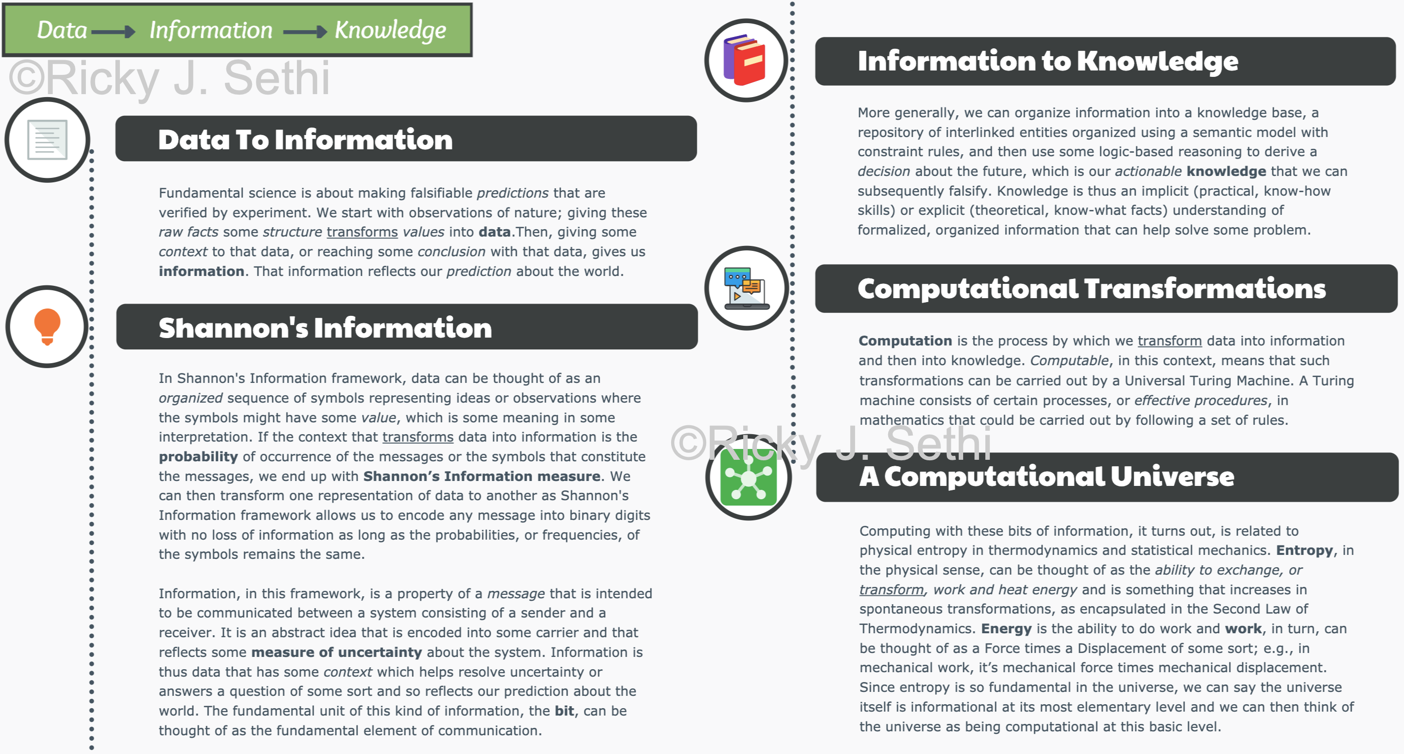
Addendum Figure 2 (from page 2)
Notes:
This is an extracted figure from the addendum (page 2).
Speaker notes:
- Orient students to the figure’s structure (axes, boxes, arrows, legends).
- Explain how to interpret each component and how it links to the main chapter.
- Highlight assumptions, limitations, and common pitfalls.
- Invite students to identify a real scenario where this figure applies.

Slide 50
Addendum Figure 2 — Walkthrough & Discussion
Step‑by‑step walkthrough of the figure
  - Define the problem context the figure addresses
  - Explain each part of the diagram and the data flow
  - Relate to model selection/evaluation choices
Key takeaways and caveats
Notes:
Instructor walkthrough:
1) Start from the top/left and trace the process to the bottom/right.
2) Emphasize decision points and criteria (e.g., data type, labels, metric).
3) Tie back to earlier slides: supervised workflow, evaluation metrics, entropy/trees, ensembles.
4) Close with an example (your domain) and 1–2 audience questions.

Slide 51
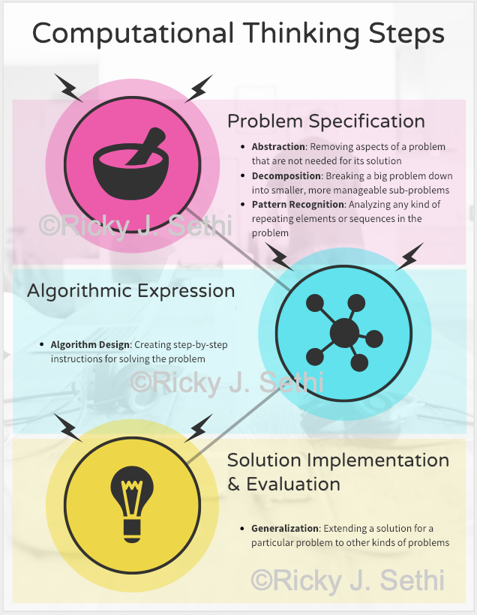
Addendum Figure 3 (from page 2)
Notes:
This is an extracted figure from the addendum (page 2).
Speaker notes:
- Orient students to the figure’s structure (axes, boxes, arrows, legends).
- Explain how to interpret each component and how it links to the main chapter.
- Highlight assumptions, limitations, and common pitfalls.
- Invite students to identify a real scenario where this figure applies.

Slide 52
Addendum Figure 3 — Walkthrough & Discussion
Step‑by‑step walkthrough of the figure
  - Define the problem context the figure addresses
  - Explain each part of the diagram and the data flow
  - Relate to model selection/evaluation choices
Key takeaways and caveats
Notes:
Instructor walkthrough:
1) Start from the top/left and trace the process to the bottom/right.
2) Emphasize decision points and criteria (e.g., data type, labels, metric).
3) Tie back to earlier slides: supervised workflow, evaluation metrics, entropy/trees, ensembles.
4) Close with an example (your domain) and 1–2 audience questions.

Slide 53
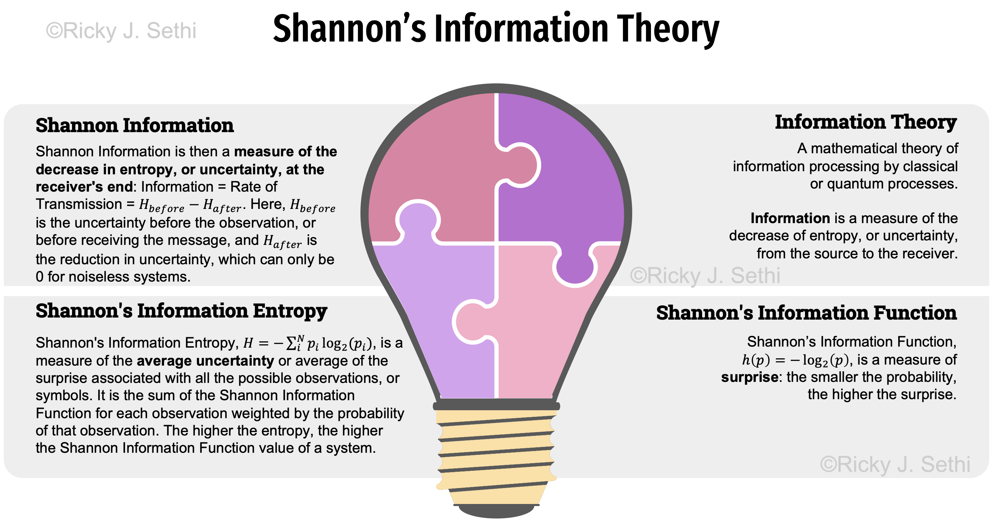
Addendum Figure 4 (from page 3)
Notes:
This is an extracted figure from the addendum (page 3).
Speaker notes:
- Orient students to the figure’s structure (axes, boxes, arrows, legends).
- Explain how to interpret each component and how it links to the main chapter.
- Highlight assumptions, limitations, and common pitfalls.
- Invite students to identify a real scenario where this figure applies.

Slide 54
Addendum Figure 4 — Walkthrough & Discussion
Step‑by‑step walkthrough of the figure
  - Define the problem context the figure addresses
  - Explain each part of the diagram and the data flow
  - Relate to model selection/evaluation choices
Key takeaways and caveats
Notes:
Instructor walkthrough:
1) Start from the top/left and trace the process to the bottom/right.
2) Emphasize decision points and criteria (e.g., data type, labels, metric).
3) Tie back to earlier slides: supervised workflow, evaluation metrics, entropy/trees, ensembles.
4) Close with an example (your domain) and 1–2 audience questions.

Slide 55
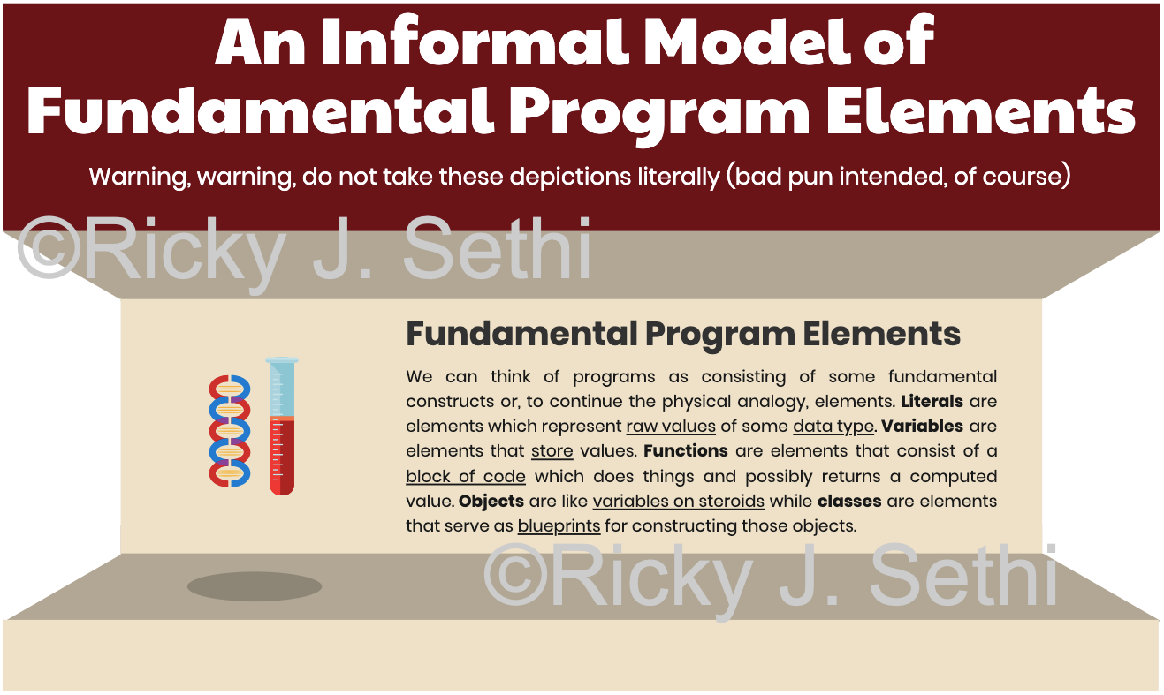
Addendum Figure 5 (from page 4)
Notes:
This is an extracted figure from the addendum (page 4).
Speaker notes:
- Orient students to the figure’s structure (axes, boxes, arrows, legends).
- Explain how to interpret each component and how it links to the main chapter.
- Highlight assumptions, limitations, and common pitfalls.
- Invite students to identify a real scenario where this figure applies.

Slide 56
Addendum Figure 5 — Walkthrough & Discussion
Step‑by‑step walkthrough of the figure
  - Define the problem context the figure addresses
  - Explain each part of the diagram and the data flow
  - Relate to model selection/evaluation choices
Key takeaways and caveats
Notes:
Instructor walkthrough:
1) Start from the top/left and trace the process to the bottom/right.
2) Emphasize decision points and criteria (e.g., data type, labels, metric).
3) Tie back to earlier slides: supervised workflow, evaluation metrics, entropy/trees, ensembles.
4) Close with an example (your domain) and 1–2 audience questions.

Slide 57
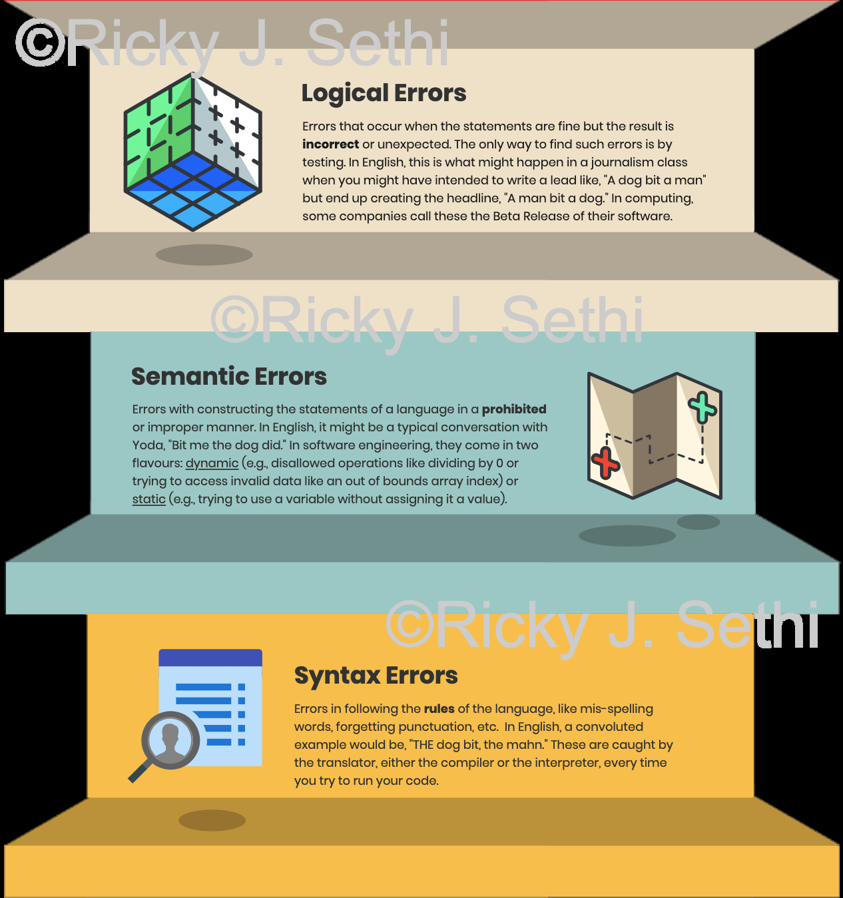
Addendum Figure 6 (from page 4)
Notes:
This is an extracted figure from the addendum (page 4).
Speaker notes:
- Orient students to the figure’s structure (axes, boxes, arrows, legends).
- Explain how to interpret each component and how it links to the main chapter.
- Highlight assumptions, limitations, and common pitfalls.
- Invite students to identify a real scenario where this figure applies.

Slide 58
Addendum Figure 6 — Walkthrough & Discussion
Step‑by‑step walkthrough of the figure
  - Define the problem context the figure addresses
  - Explain each part of the diagram and the data flow
  - Relate to model selection/evaluation choices
Key takeaways and caveats
Notes:
Instructor walkthrough:
1) Start from the top/left and trace the process to the bottom/right.
2) Emphasize decision points and criteria (e.g., data type, labels, metric).
3) Tie back to earlier slides: supervised workflow, evaluation metrics, entropy/trees, ensembles.
4) Close with an example (your domain) and 1–2 audience questions.

Slide 59
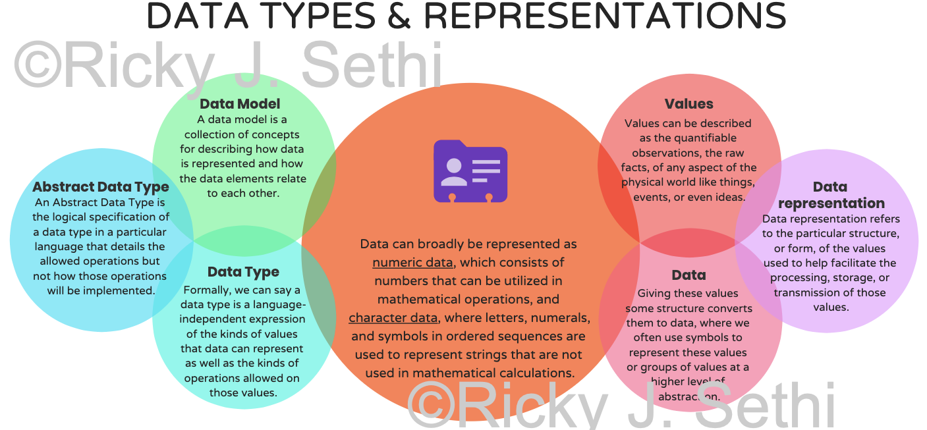
Addendum Figure 7 (from page 5)
Notes:
This is an extracted figure from the addendum (page 5).
Speaker notes:
- Orient students to the figure’s structure (axes, boxes, arrows, legends).
- Explain how to interpret each component and how it links to the main chapter.
- Highlight assumptions, limitations, and common pitfalls.
- Invite students to identify a real scenario where this figure applies.

Slide 60
Addendum Figure 7 — Walkthrough & Discussion
Step‑by‑step walkthrough of the figure
  - Define the problem context the figure addresses
  - Explain each part of the diagram and the data flow
  - Relate to model selection/evaluation choices
Key takeaways and caveats
Notes:
Instructor walkthrough:
1) Start from the top/left and trace the process to the bottom/right.
2) Emphasize decision points and criteria (e.g., data type, labels, metric).
3) Tie back to earlier slides: supervised workflow, evaluation metrics, entropy/trees, ensembles.
4) Close with an example (your domain) and 1–2 audience questions.

Slide 61
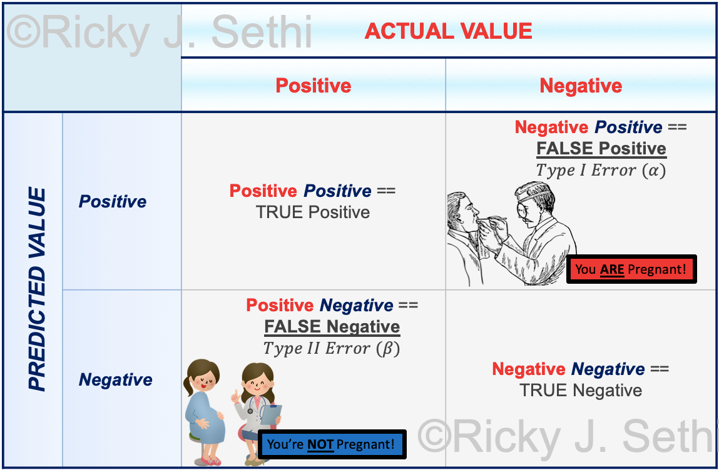
Addendum Figure 8 (from page 5)
Notes:
This is an extracted figure from the addendum (page 5).
Speaker notes:
- Orient students to the figure’s structure (axes, boxes, arrows, legends).
- Explain how to interpret each component and how it links to the main chapter.
- Highlight assumptions, limitations, and common pitfalls.
- Invite students to identify a real scenario where this figure applies.

Slide 62
Addendum Figure 8 — Walkthrough & Discussion
Step‑by‑step walkthrough of the figure
  - Define the problem context the figure addresses
  - Explain each part of the diagram and the data flow
  - Relate to model selection/evaluation choices
Key takeaways and caveats
Notes:
Instructor walkthrough:
1) Start from the top/left and trace the process to the bottom/right.
2) Emphasize decision points and criteria (e.g., data type, labels, metric).
3) Tie back to earlier slides: supervised workflow, evaluation metrics, entropy/trees, ensembles.
4) Close with an example (your domain) and 1–2 audience questions.

Slide 63
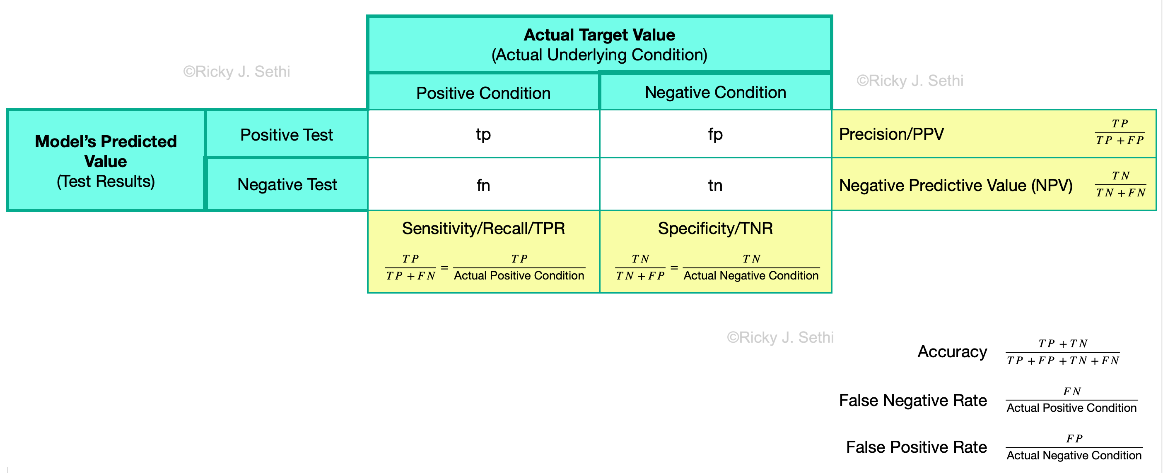
Addendum Figure 9 (from page 6)
Notes:
This is an extracted figure from the addendum (page 6).
Speaker notes:
- Orient students to the figure’s structure (axes, boxes, arrows, legends).
- Explain how to interpret each component and how it links to the main chapter.
- Highlight assumptions, limitations, and common pitfalls.
- Invite students to identify a real scenario where this figure applies.

Slide 64
Addendum Figure 9 — Walkthrough & Discussion
Step‑by‑step walkthrough of the figure
  - Define the problem context the figure addresses
  - Explain each part of the diagram and the data flow
  - Relate to model selection/evaluation choices
Key takeaways and caveats
Notes:
Instructor walkthrough:
1) Start from the top/left and trace the process to the bottom/right.
2) Emphasize decision points and criteria (e.g., data type, labels, metric).
3) Tie back to earlier slides: supervised workflow, evaluation metrics, entropy/trees, ensembles.
4) Close with an example (your domain) and 1–2 audience questions.

Slide 65
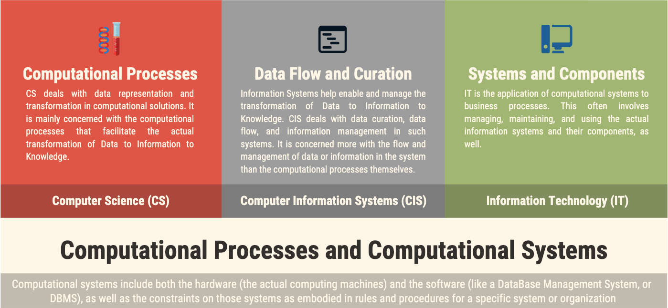
Addendum Figure 10 (from page 6)
Notes:
This is an extracted figure from the addendum (page 6).
Speaker notes:
- Orient students to the figure’s structure (axes, boxes, arrows, legends).
- Explain how to interpret each component and how it links to the main chapter.
- Highlight assumptions, limitations, and common pitfalls.
- Invite students to identify a real scenario where this figure applies.

Slide 66
Addendum Figure 10 — Walkthrough & Discussion
Step‑by‑step walkthrough of the figure
  - Define the problem context the figure addresses
  - Explain each part of the diagram and the data flow
  - Relate to model selection/evaluation choices
Key takeaways and caveats
Notes:
Instructor walkthrough:
1) Start from the top/left and trace the process to the bottom/right.
2) Emphasize decision points and criteria (e.g., data type, labels, metric).
3) Tie back to earlier slides: supervised workflow, evaluation metrics, entropy/trees, ensembles.
4) Close with an example (your domain) and 1–2 audience questions.

Slide 67
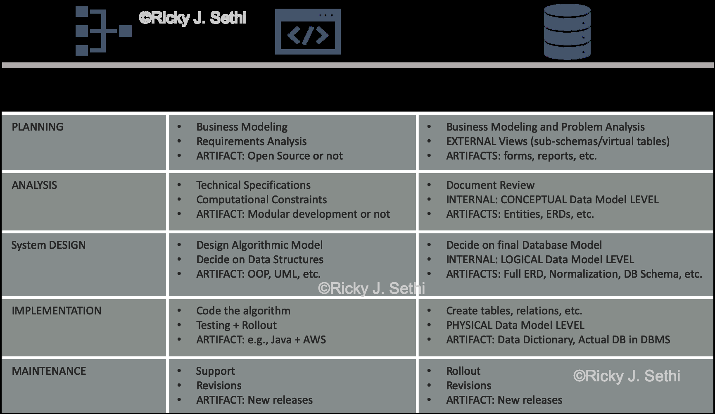
Addendum Figure 11 (from page 6)
Notes:
This is an extracted figure from the addendum (page 6).
Speaker notes:
- Orient students to the figure’s structure (axes, boxes, arrows, legends).
- Explain how to interpret each component and how it links to the main chapter.
- Highlight assumptions, limitations, and common pitfalls.
- Invite students to identify a real scenario where this figure applies.

Slide 68
Addendum Figure 11 — Walkthrough & Discussion
Step‑by‑step walkthrough of the figure
  - Define the problem context the figure addresses
  - Explain each part of the diagram and the data flow
  - Relate to model selection/evaluation choices
Key takeaways and caveats
Notes:
Instructor walkthrough:
1) Start from the top/left and trace the process to the bottom/right.
2) Emphasize decision points and criteria (e.g., data type, labels, metric).
3) Tie back to earlier slides: supervised workflow, evaluation metrics, entropy/trees, ensembles.
4) Close with an example (your domain) and 1–2 audience questions.

Slide 69
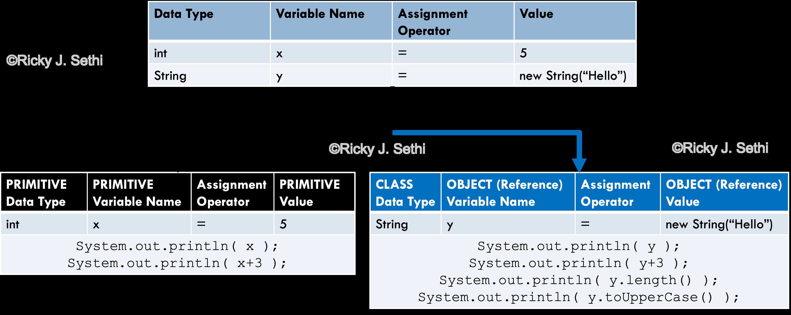
Addendum Figure 12 (from page 7)
Notes:
This is an extracted figure from the addendum (page 7).
Speaker notes:
- Orient students to the figure’s structure (axes, boxes, arrows, legends).
- Explain how to interpret each component and how it links to the main chapter.
- Highlight assumptions, limitations, and common pitfalls.
- Invite students to identify a real scenario where this figure applies.

Slide 70
Addendum Figure 12 — Walkthrough & Discussion
Step‑by‑step walkthrough of the figure
  - Define the problem context the figure addresses
  - Explain each part of the diagram and the data flow
  - Relate to model selection/evaluation choices
Key takeaways and caveats
Notes:
Instructor walkthrough:
1) Start from the top/left and trace the process to the bottom/right.
2) Emphasize decision points and criteria (e.g., data type, labels, metric).
3) Tie back to earlier slides: supervised workflow, evaluation metrics, entropy/trees, ensembles.
4) Close with an example (your domain) and 1–2 audience questions.

Slide 71
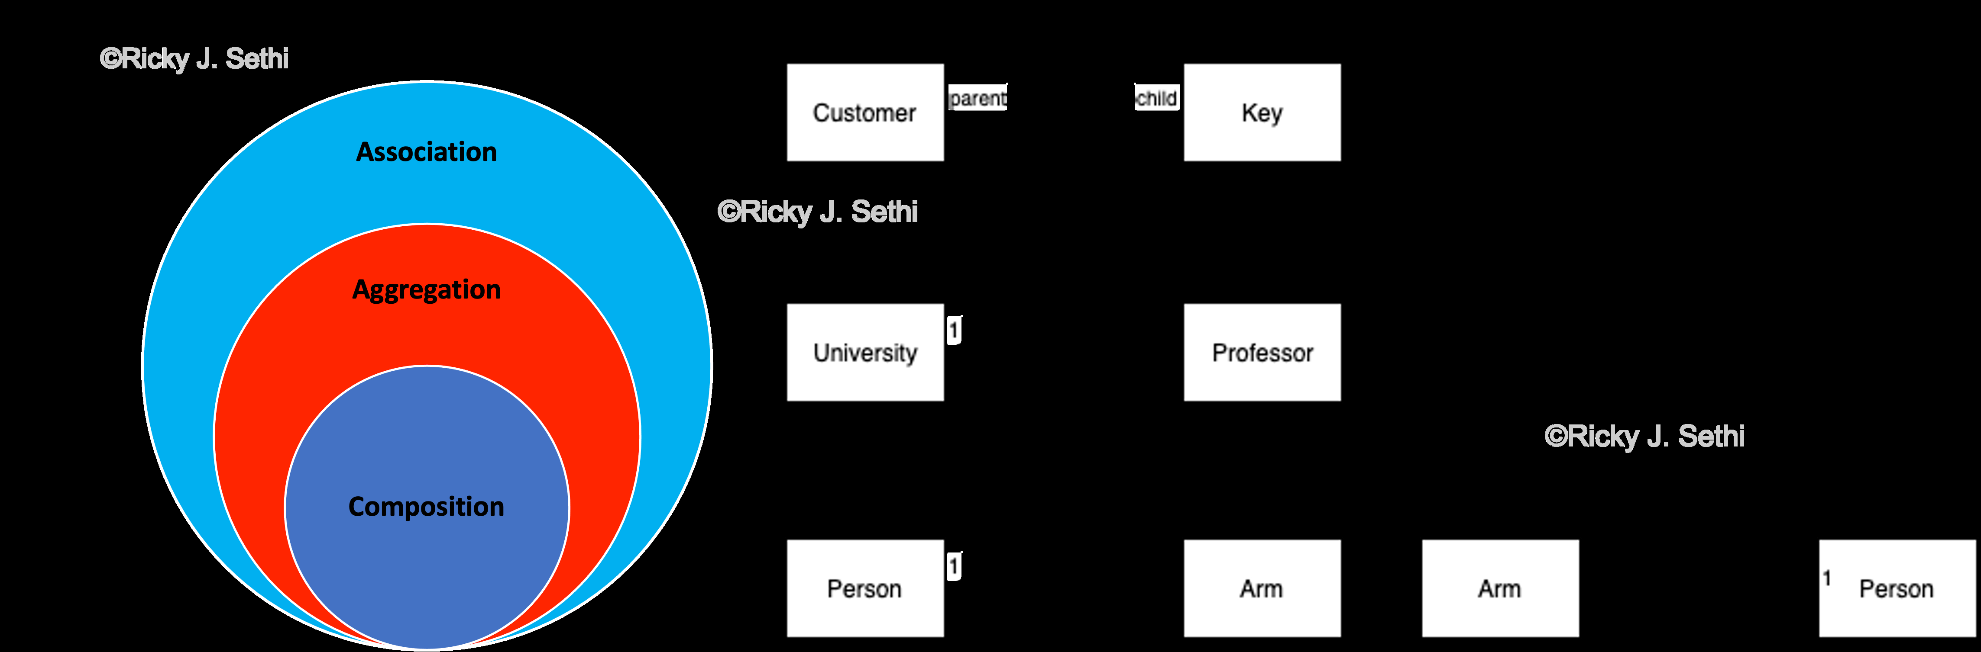
Addendum Figure 13 (from page 7)
Notes:
This is an extracted figure from the addendum (page 7).
Speaker notes:
- Orient students to the figure’s structure (axes, boxes, arrows, legends).
- Explain how to interpret each component and how it links to the main chapter.
- Highlight assumptions, limitations, and common pitfalls.
- Invite students to identify a real scenario where this figure applies.

Slide 72
Addendum Figure 13 — Walkthrough & Discussion
Step‑by‑step walkthrough of the figure
  - Define the problem context the figure addresses
  - Explain each part of the diagram and the data flow
  - Relate to model selection/evaluation choices
Key takeaways and caveats
Notes:
Instructor walkthrough:
1) Start from the top/left and trace the process to the bottom/right.
2) Emphasize decision points and criteria (e.g., data type, labels, metric).
3) Tie back to earlier slides: supervised workflow, evaluation metrics, entropy/trees, ensembles.
4) Close with an example (your domain) and 1–2 audience questions.

Slide 73
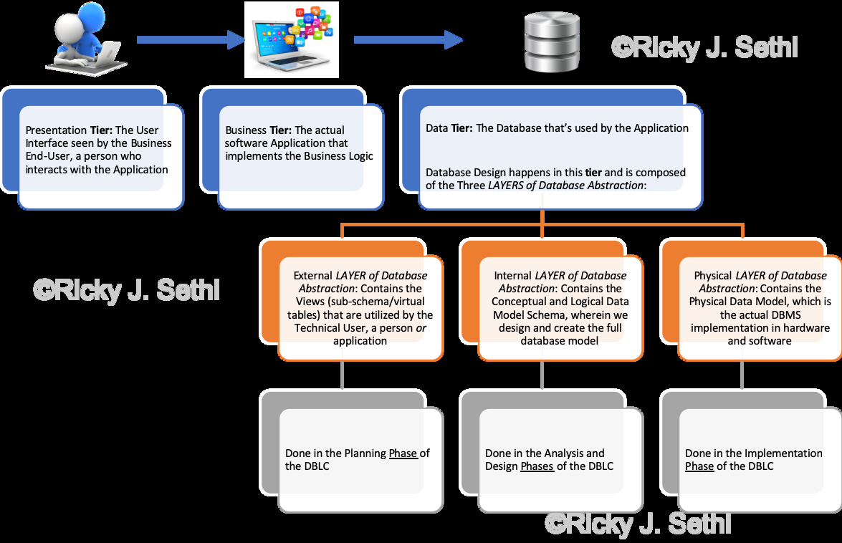
Addendum Figure 14 (from page 7)
Notes:
This is an extracted figure from the addendum (page 7).
Speaker notes:
- Orient students to the figure’s structure (axes, boxes, arrows, legends).
- Explain how to interpret each component and how it links to the main chapter.
- Highlight assumptions, limitations, and common pitfalls.
- Invite students to identify a real scenario where this figure applies.

Slide 74
Addendum Figure 14 — Walkthrough & Discussion
Step‑by‑step walkthrough of the figure
  - Define the problem context the figure addresses
  - Explain each part of the diagram and the data flow
  - Relate to model selection/evaluation choices
Key takeaways and caveats
Notes:
Instructor walkthrough:
1) Start from the top/left and trace the process to the bottom/right.
2) Emphasize decision points and criteria (e.g., data type, labels, metric).
3) Tie back to earlier slides: supervised workflow, evaluation metrics, entropy/trees, ensembles.
4) Close with an example (your domain) and 1–2 audience questions.

Slide 75
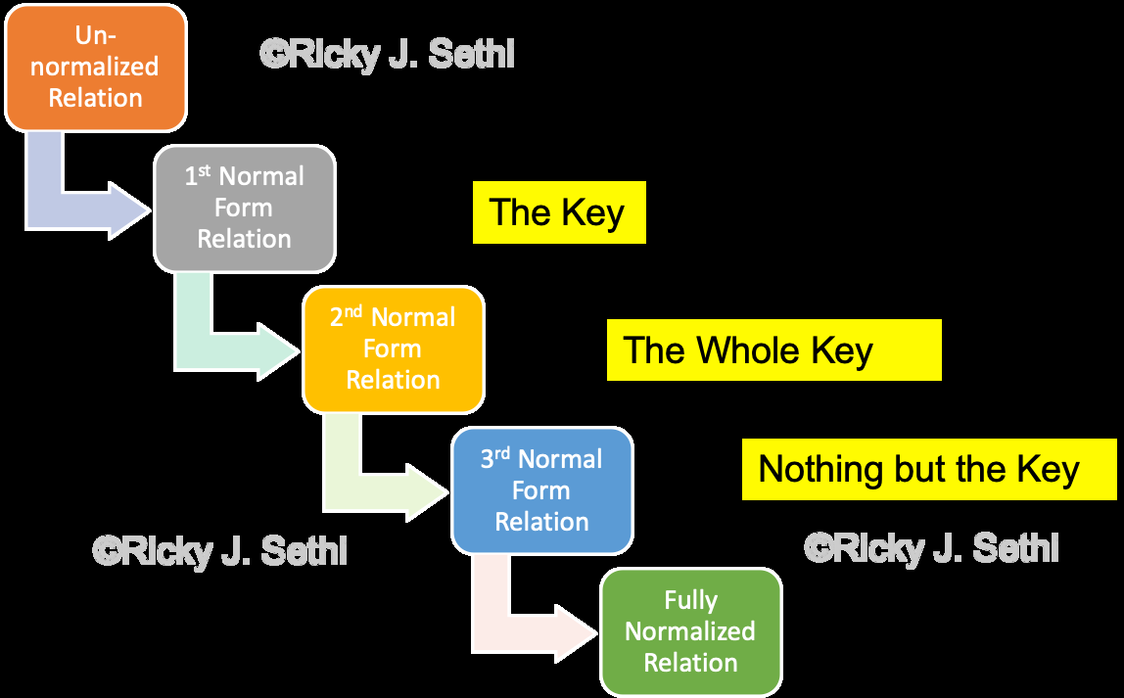
Addendum Figure 15 (from page 8)
Notes:
This is an extracted figure from the addendum (page 8).
Speaker notes:
- Orient students to the figure’s structure (axes, boxes, arrows, legends).
- Explain how to interpret each component and how it links to the main chapter.
- Highlight assumptions, limitations, and common pitfalls.
- Invite students to identify a real scenario where this figure applies.

Slide 76
Addendum Figure 15 — Walkthrough & Discussion
Step‑by‑step walkthrough of the figure
  - Define the problem context the figure addresses
  - Explain each part of the diagram and the data flow
  - Relate to model selection/evaluation choices
Key takeaways and caveats
Notes:
Instructor walkthrough:
1) Start from the top/left and trace the process to the bottom/right.
2) Emphasize decision points and criteria (e.g., data type, labels, metric).
3) Tie back to earlier slides: supervised workflow, evaluation metrics, entropy/trees, ensembles.
4) Close with an example (your domain) and 1–2 audience questions.

Slide 77
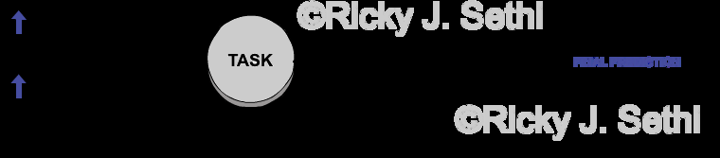
Addendum Figure 16 (from page 8)
Notes:
This is an extracted figure from the addendum (page 8).
Speaker notes:
- Orient students to the figure’s structure (axes, boxes, arrows, legends).
- Explain how to interpret each component and how it links to the main chapter.
- Highlight assumptions, limitations, and common pitfalls.
- Invite students to identify a real scenario where this figure applies.

Slide 78
Addendum Figure 16 — Walkthrough & Discussion
Step‑by‑step walkthrough of the figure
  - Define the problem context the figure addresses
  - Explain each part of the diagram and the data flow
  - Relate to model selection/evaluation choices
Key takeaways and caveats
Notes:
Instructor walkthrough:
1) Start from the top/left and trace the process to the bottom/right.
2) Emphasize decision points and criteria (e.g., data type, labels, metric).
3) Tie back to earlier slides: supervised workflow, evaluation metrics, entropy/trees, ensembles.
4) Close with an example (your domain) and 1–2 audience questions.

Slide 79
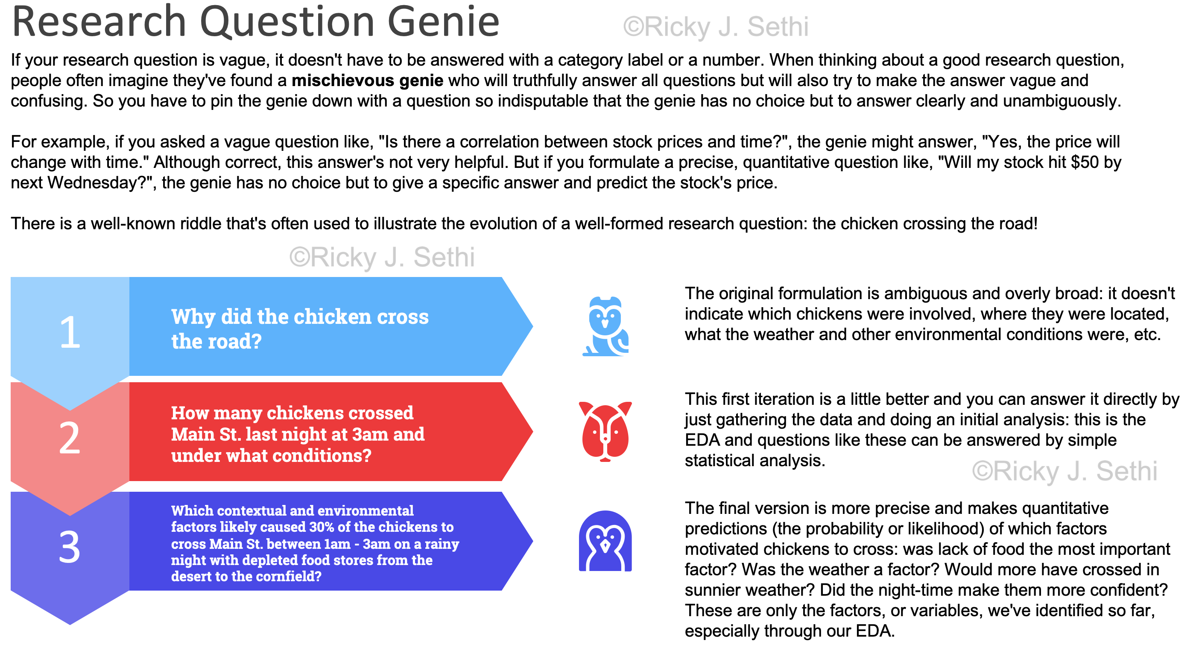
Addendum Figure 17 (from page 8)
Notes:
This is an extracted figure from the addendum (page 8).
Speaker notes:
- Orient students to the figure’s structure (axes, boxes, arrows, legends).
- Explain how to interpret each component and how it links to the main chapter.
- Highlight assumptions, limitations, and common pitfalls.
- Invite students to identify a real scenario where this figure applies.

Slide 80
Addendum Figure 17 — Walkthrough & Discussion
Step‑by‑step walkthrough of the figure
  - Define the problem context the figure addresses
  - Explain each part of the diagram and the data flow
  - Relate to model selection/evaluation choices
Key takeaways and caveats
Notes:
Instructor walkthrough:
1) Start from the top/left and trace the process to the bottom/right.
2) Emphasize decision points and criteria (e.g., data type, labels, metric).
3) Tie back to earlier slides: supervised workflow, evaluation metrics, entropy/trees, ensembles.
4) Close with an example (your domain) and 1–2 audience questions.

Slide 81
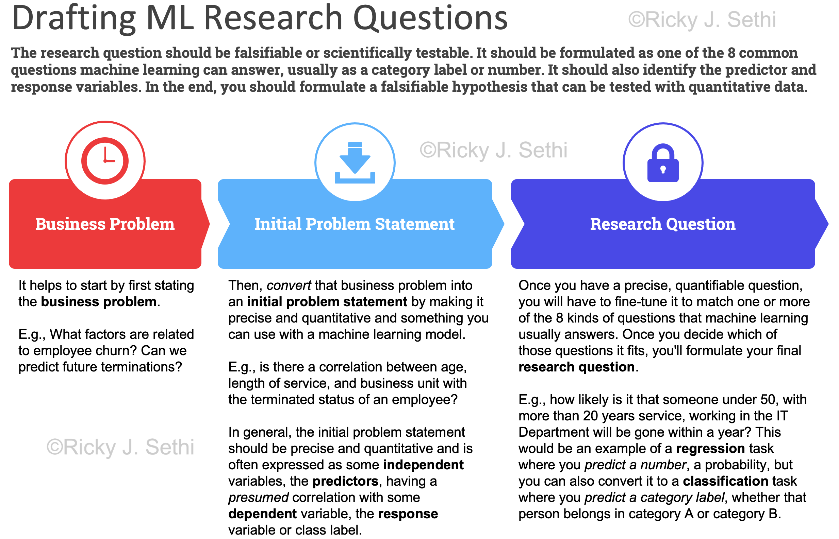
Addendum Figure 18 (from page 9)
Notes:
This is an extracted figure from the addendum (page 9).
Speaker notes:
- Orient students to the figure’s structure (axes, boxes, arrows, legends).
- Explain how to interpret each component and how it links to the main chapter.
- Highlight assumptions, limitations, and common pitfalls.
- Invite students to identify a real scenario where this figure applies.

Slide 82
Addendum Figure 18 — Walkthrough & Discussion
Step‑by‑step walkthrough of the figure
  - Define the problem context the figure addresses
  - Explain each part of the diagram and the data flow
  - Relate to model selection/evaluation choices
Key takeaways and caveats
Notes:
Instructor walkthrough:
1) Start from the top/left and trace the process to the bottom/right.
2) Emphasize decision points and criteria (e.g., data type, labels, metric).
3) Tie back to earlier slides: supervised workflow, evaluation metrics, entropy/trees, ensembles.
4) Close with an example (your domain) and 1–2 audience questions.

Slide 83
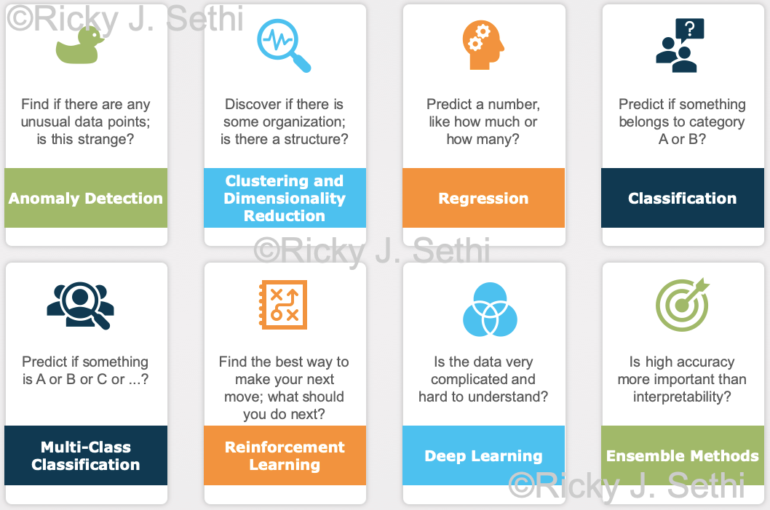
Addendum Figure 19 (from page 9)
Notes:
This is an extracted figure from the addendum (page 9).
Speaker notes:
- Orient students to the figure’s structure (axes, boxes, arrows, legends).
- Explain how to interpret each component and how it links to the main chapter.
- Highlight assumptions, limitations, and common pitfalls.
- Invite students to identify a real scenario where this figure applies.

Slide 84
Addendum Figure 19 — Walkthrough & Discussion
Step‑by‑step walkthrough of the figure
  - Define the problem context the figure addresses
  - Explain each part of the diagram and the data flow
  - Relate to model selection/evaluation choices
Key takeaways and caveats
Notes:
Instructor walkthrough:
1) Start from the top/left and trace the process to the bottom/right.
2) Emphasize decision points and criteria (e.g., data type, labels, metric).
3) Tie back to earlier slides: supervised workflow, evaluation metrics, entropy/trees, ensembles.
4) Close with an example (your domain) and 1–2 audience questions.

Slide 85
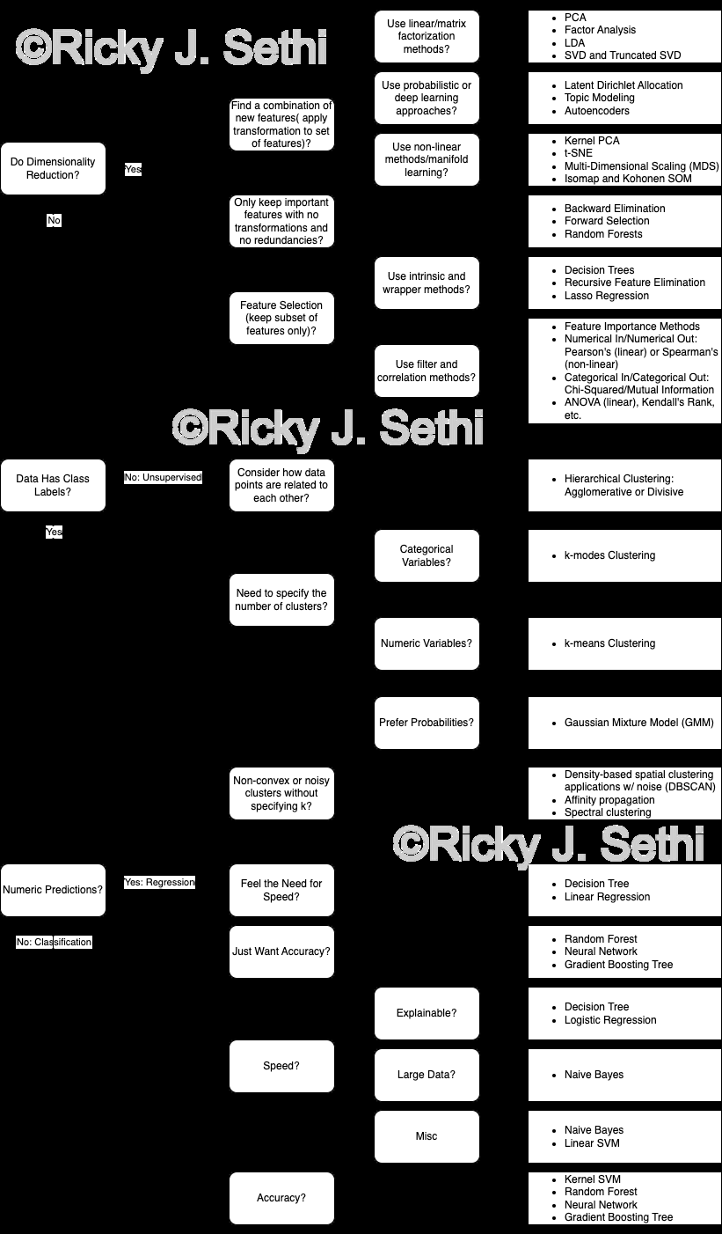
Addendum Figure 20 (from page 10)
Notes:
This is an extracted figure from the addendum (page 10).
Speaker notes:
- Orient students to the figure’s structure (axes, boxes, arrows, legends).
- Explain how to interpret each component and how it links to the main chapter.
- Highlight assumptions, limitations, and common pitfalls.
- Invite students to identify a real scenario where this figure applies.

Slide 86
Addendum Figure 20 — Walkthrough & Discussion
Step‑by‑step walkthrough of the figure
  - Define the problem context the figure addresses
  - Explain each part of the diagram and the data flow
  - Relate to model selection/evaluation choices
Key takeaways and caveats
Notes:
Instructor walkthrough:
1) Start from the top/left and trace the process to the bottom/right.
2) Emphasize decision points and criteria (e.g., data type, labels, metric).
3) Tie back to earlier slides: supervised workflow, evaluation metrics, entropy/trees, ensembles.
4) Close with an example (your domain) and 1–2 audience questions.

Slide 87
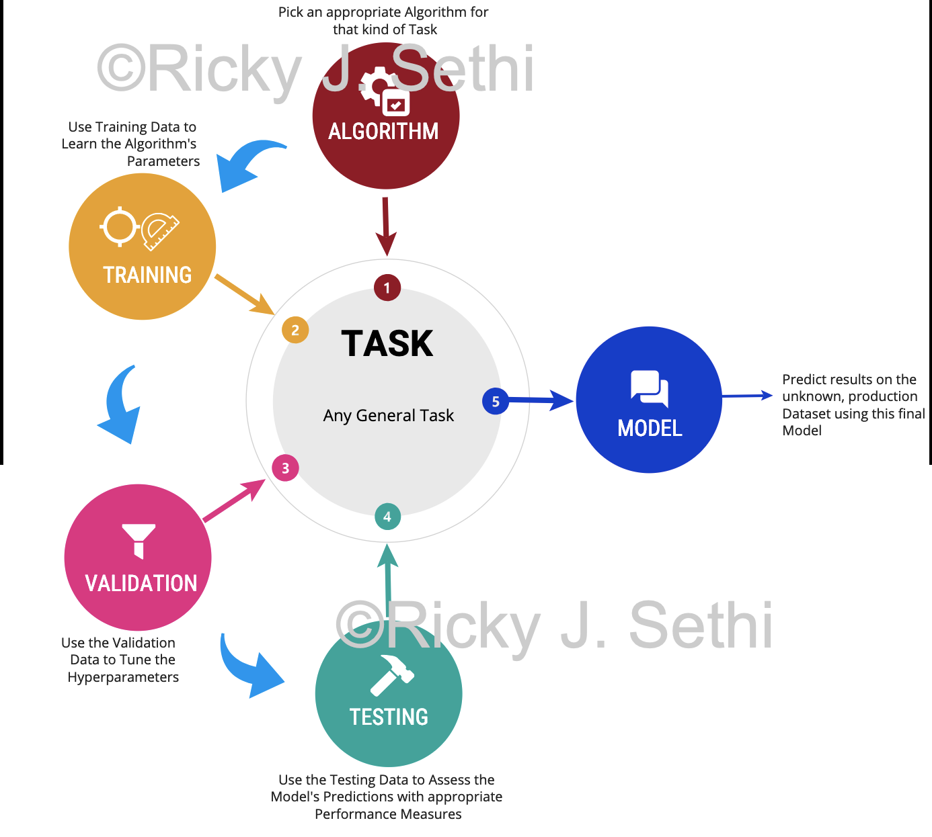
Addendum Figure 21 (from page 11)
Notes:
This is an extracted figure from the addendum (page 11).
Speaker notes:
- Orient students to the figure’s structure (axes, boxes, arrows, legends).
- Explain how to interpret each component and how it links to the main chapter.
- Highlight assumptions, limitations, and common pitfalls.
- Invite students to identify a real scenario where this figure applies.

Slide 88
Addendum Figure 21 — Walkthrough & Discussion
Step‑by‑step walkthrough of the figure
  - Define the problem context the figure addresses
  - Explain each part of the diagram and the data flow
  - Relate to model selection/evaluation choices
Key takeaways and caveats
Notes:
Instructor walkthrough:
1) Start from the top/left and trace the process to the bottom/right.
2) Emphasize decision points and criteria (e.g., data type, labels, metric).
3) Tie back to earlier slides: supervised workflow, evaluation metrics, entropy/trees, ensembles.
4) Close with an example (your domain) and 1–2 audience questions.

Slide 89
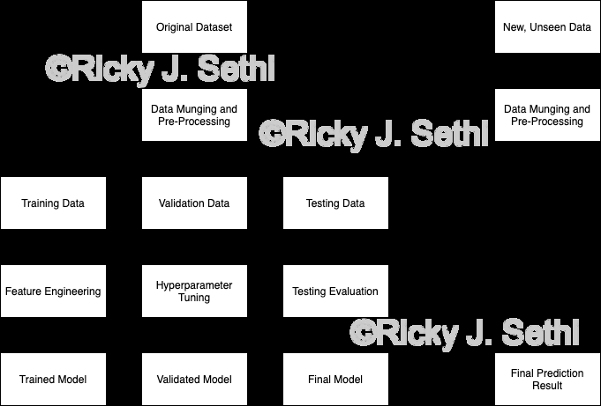
Addendum Figure 22 (from page 11)
Notes:
This is an extracted figure from the addendum (page 11).
Speaker notes:
- Orient students to the figure’s structure (axes, boxes, arrows, legends).
- Explain how to interpret each component and how it links to the main chapter.
- Highlight assumptions, limitations, and common pitfalls.
- Invite students to identify a real scenario where this figure applies.

Slide 90
Addendum Figure 22 — Walkthrough & Discussion
Step‑by‑step walkthrough of the figure
  - Define the problem context the figure addresses
  - Explain each part of the diagram and the data flow
  - Relate to model selection/evaluation choices
Key takeaways and caveats
Notes:
Instructor walkthrough:
1) Start from the top/left and trace the process to the bottom/right.
2) Emphasize decision points and criteria (e.g., data type, labels, metric).
3) Tie back to earlier slides: supervised workflow, evaluation metrics, entropy/trees, ensembles.
4) Close with an example (your domain) and 1–2 audience questions.

Slide 91
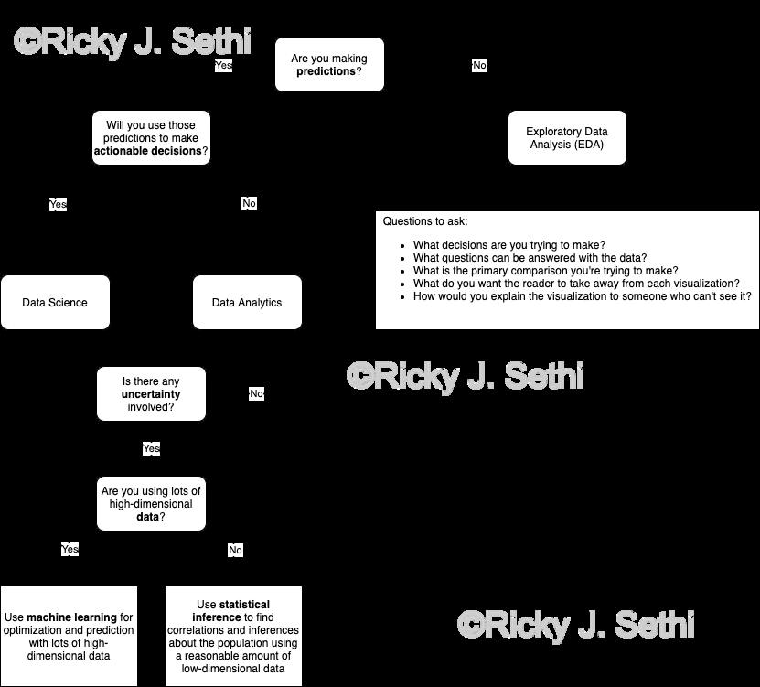
Addendum Figure 23 (from page 12)
Notes:
This is an extracted figure from the addendum (page 12).
Speaker notes:
- Orient students to the figure’s structure (axes, boxes, arrows, legends).
- Explain how to interpret each component and how it links to the main chapter.
- Highlight assumptions, limitations, and common pitfalls.
- Invite students to identify a real scenario where this figure applies.

Slide 92
Addendum Figure 23 — Walkthrough & Discussion
Step‑by‑step walkthrough of the figure
  - Define the problem context the figure addresses
  - Explain each part of the diagram and the data flow
  - Relate to model selection/evaluation choices
Key takeaways and caveats
Notes:
Instructor walkthrough:
1) Start from the top/left and trace the process to the bottom/right.
2) Emphasize decision points and criteria (e.g., data type, labels, metric).
3) Tie back to earlier slides: supervised workflow, evaluation metrics, entropy/trees, ensembles.
4) Close with an example (your domain) and 1–2 audience questions.

Slide 93

Addendum Figure 24 (from page 13)
Notes:
This is an extracted figure from the addendum (page 13).
Speaker notes:
- Orient students to the figure’s structure (axes, boxes, arrows, legends).
- Explain how to interpret each component and how it links to the main chapter.
- Highlight assumptions, limitations, and common pitfalls.
- Invite students to identify a real scenario where this figure applies.

Slide 94
Addendum Figure 24 — Walkthrough & Discussion
Step‑by‑step walkthrough of the figure
  - Define the problem context the figure addresses
  - Explain each part of the diagram and the data flow
  - Relate to model selection/evaluation choices
Key takeaways and caveats
Notes:
Instructor walkthrough:
1) Start from the top/left and trace the process to the bottom/right.
2) Emphasize decision points and criteria (e.g., data type, labels, metric).
3) Tie back to earlier slides: supervised workflow, evaluation metrics, entropy/trees, ensembles.
4) Close with an example (your domain) and 1–2 audience questions.

Slide 95
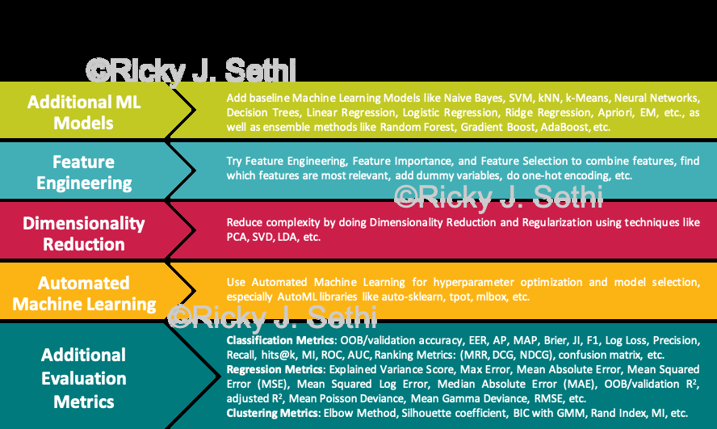
Addendum Figure 25 (from page 13)
Notes:
This is an extracted figure from the addendum (page 13).
Speaker notes:
- Orient students to the figure’s structure (axes, boxes, arrows, legends).
- Explain how to interpret each component and how it links to the main chapter.
- Highlight assumptions, limitations, and common pitfalls.
- Invite students to identify a real scenario where this figure applies.

Slide 96
Addendum Figure 25 — Walkthrough & Discussion
Step‑by‑step walkthrough of the figure
  - Define the problem context the figure addresses
  - Explain each part of the diagram and the data flow
  - Relate to model selection/evaluation choices
Key takeaways and caveats
Notes:
Instructor walkthrough:
1) Start from the top/left and trace the process to the bottom/right.
2) Emphasize decision points and criteria (e.g., data type, labels, metric).
3) Tie back to earlier slides: supervised workflow, evaluation metrics, entropy/trees, ensembles.
4) Close with an example (your domain) and 1–2 audience questions.

Slide 97
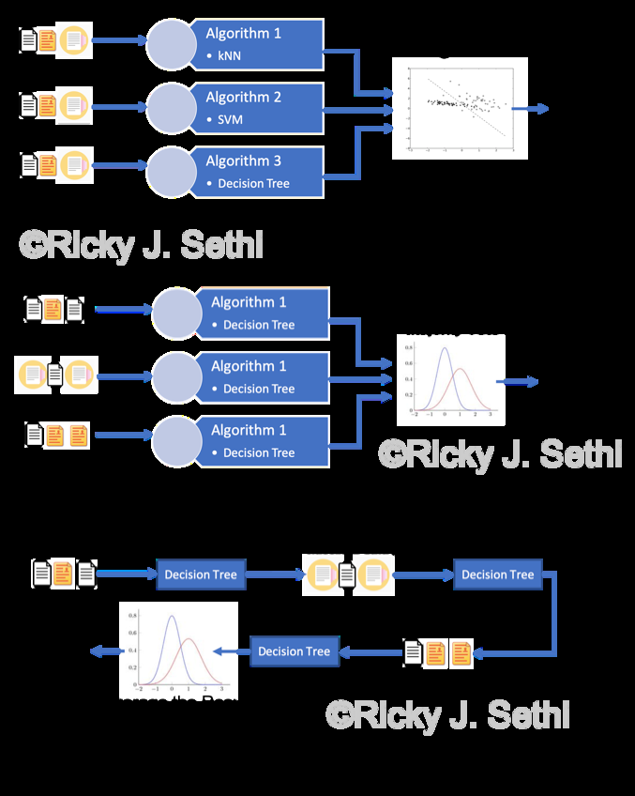
Addendum Figure 26 (from page 14)
Notes:
This is an extracted figure from the addendum (page 14).
Speaker notes:
- Orient students to the figure’s structure (axes, boxes, arrows, legends).
- Explain how to interpret each component and how it links to the main chapter.
- Highlight assumptions, limitations, and common pitfalls.
- Invite students to identify a real scenario where this figure applies.

Slide 98
Addendum Figure 26 — Walkthrough & Discussion
Step‑by‑step walkthrough of the figure
  - Define the problem context the figure addresses
  - Explain each part of the diagram and the data flow
  - Relate to model selection/evaluation choices
Key takeaways and caveats
Notes:
Instructor walkthrough:
1) Start from the top/left and trace the process to the bottom/right.
2) Emphasize decision points and criteria (e.g., data type, labels, metric).
3) Tie back to earlier slides: supervised workflow, evaluation metrics, entropy/trees, ensembles.
4) Close with an example (your domain) and 1–2 audience questions.

Slide 99
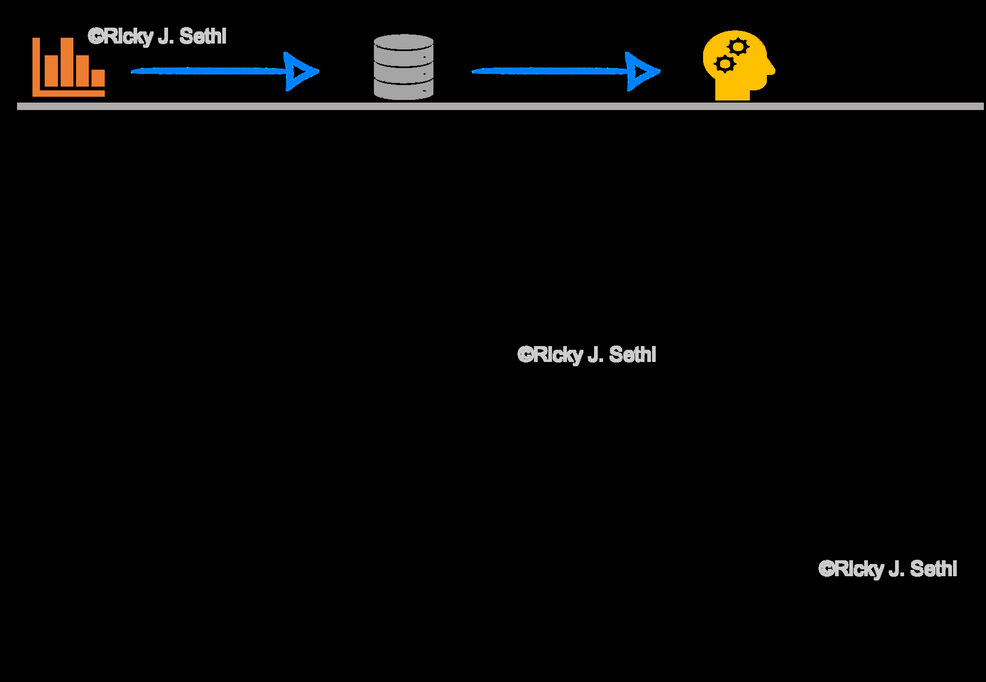
Addendum Figure 27 (from page 14)
Notes:
This is an extracted figure from the addendum (page 14).
Speaker notes:
- Orient students to the figure’s structure (axes, boxes, arrows, legends).
- Explain how to interpret each component and how it links to the main chapter.
- Highlight assumptions, limitations, and common pitfalls.
- Invite students to identify a real scenario where this figure applies.

Slide 100
Addendum Figure 27 — Walkthrough & Discussion
Step‑by‑step walkthrough of the figure
  - Define the problem context the figure addresses
  - Explain each part of the diagram and the data flow
  - Relate to model selection/evaluation choices
Key takeaways and caveats
Notes:
Instructor walkthrough:
1) Start from the top/left and trace the process to the bottom/right.
2) Emphasize decision points and criteria (e.g., data type, labels, metric).
3) Tie back to earlier slides: supervised workflow, evaluation metrics, entropy/trees, ensembles.
4) Close with an example (your domain) and 1–2 audience questions.

Slide 101
Exercises — What is ML? (Mitchell + Turing) (MCQs)
1. Which element is NOT part of Mitchell’s definition?
  (1) Task (T)
  (2) Experience (E)
  (3) Performance (P)
  (4) Model architecture (A)
2. Which statement best describes 'Experience'?
  (1) Labeled/Unlabeled data used to learn
  (2) Final trained weights
  (3) The loss function
  (4) The test set only
Notes:
Instructor notes:
- Discuss each MCQ briefly.
- Solicit justifications before revealing answers.
Answers (index):
1) 4
2) 1

Slide 102
Exercises — What is ML? (Mitchell + Turing) (Short Answer)
1. Give an everyday example of T/E/P in your domain.
2. How would you decide that performance is 'sufficient' for deployment?
Notes:
Instructor notes:
- Give 2–4 minutes for pair discussion, then cold‑call a few answers.
- Encourage linking to metrics and sources of error.
- Capture key points on the board.

Slide 103
Exercises — Supervised Learning in a Nutshell (MCQs)
1. Decision boundaries are learned to:
  (1) Memorize training labels
  (2) Separate classes in feature space
  (3) Generate synthetic data
  (4) Calibrate probabilities only
2. Which can yield curvy/nonlinear boundaries?
  (1) Linear regression
  (2) Decision trees/ensembles
  (3) k‑NN only
  (4) None
Notes:
Instructor notes:
- Discuss each MCQ briefly.
- Solicit justifications before revealing answers.
Answers (index):
1) 2
2) 2

Slide 104
Exercises — Supervised Learning in a Nutshell (Short Answer)
1. Sketch (roughly) a boundary for a 2‑feature dataset you know.
2. Name two risks that lead to overfitting and how to mitigate them.
Notes:
Instructor notes:
- Give 2–4 minutes for pair discussion, then cold‑call a few answers.
- Encourage linking to metrics and sources of error.
- Capture key points on the board.

Slide 105
Exercises — Workflow: Train/Validate/Test (MCQs)
1. Why hold out a test set until the end?
  (1) To save time
  (2) To prevent leakage and unbiased generalization estimate
  (3) Because models cannot see it
  (4) Regulatory reasons only
2. Cross‑validation is most useful when:
  (1) Data is extremely large
  (2) Data is limited and we need stable estimates
  (3) We ignore hyperparameters
  (4) Only for deep nets
Notes:
Instructor notes:
- Discuss each MCQ briefly.
- Solicit justifications before revealing answers.
Answers (index):
1) 2
2) 2

Slide 106
Exercises — Workflow: Train/Validate/Test (Short Answer)
1. Design a split strategy for a small, imbalanced dataset.
2. List 3 sources of data leakage and how to avoid them.
Notes:
Instructor notes:
- Give 2–4 minutes for pair discussion, then cold‑call a few answers.
- Encourage linking to metrics and sources of error.
- Capture key points on the board.

Slide 107
Exercises — Evaluation & Hypothesis Testing (preview) (MCQs)
1. Precision increases when:
  (1) Fewer false positives
  (2) More true negatives
  (3) Fewer false negatives
  (4) More true positives always
2. Statistical power is:
  (1) 1 − β
  (2) α
  (3) p‑value
  (4) Type I error
Notes:
Instructor notes:
- Discuss each MCQ briefly.
- Solicit justifications before revealing answers.
Answers (index):
1) 1
2) 1

Slide 108
Exercises — Evaluation & Hypothesis Testing (preview) (Short Answer)
1. When would you prefer PR AUC over ROC AUC and why?
2. Outline a test to compare two classifiers’ F1 scores.
Notes:
Instructor notes:
- Give 2–4 minutes for pair discussion, then cold‑call a few answers.
- Encourage linking to metrics and sources of error.
- Capture key points on the board.

Slide 109
Exercises — Entropy & Information Gain → Decision Trees (MCQs)
1. Entropy is highest when:
  (1) Classes are balanced
  (2) One class dominates
  (3) There are many features
  (4) Tree depth is large
2. Information gain chooses the split that:
  (1) Maximizes child entropy
  (2) Minimizes parent entropy
  (3) Maximizes entropy reduction
  (4) Equalizes child counts
Notes:
Instructor notes:
- Discuss each MCQ briefly.
- Solicit justifications before revealing answers.
Answers (index):
1) 1
2) 3

Slide 110
Exercises — Entropy & Information Gain → Decision Trees (Short Answer)
1. Compute entropy for a node with 9 positive / 7 negative examples.
2. Name two reasons to prune or regularize a tree.
Notes:
Instructor notes:
- Give 2–4 minutes for pair discussion, then cold‑call a few answers.
- Encourage linking to metrics and sources of error.
- Capture key points on the board.

Slide 111
Exercises — Ensembles (Bagging, Boosting, Stacking) (MCQs)
1. Bagging primarily reduces:
  (1) Bias
  (2) Variance
  (3) Both equally
  (4) Neither
2. Boosting focuses on:
  (1) Random subsets of features
  (2) Misclassified examples sequentially
  (3) Parameter averaging
  (4) Feature selection only
Notes:
Instructor notes:
- Discuss each MCQ briefly.
- Solicit justifications before revealing answers.
Answers (index):
1) 2
2) 2

Slide 112
Exercises — Ensembles (Bagging, Boosting, Stacking) (Short Answer)
1. Give one scenario where Random Forest is a better baseline than a linear model.
2. What regularization/early stopping strategies would you use with boosting?
Notes:
Instructor notes:
- Give 2–4 minutes for pair discussion, then cold‑call a few answers.
- Encourage linking to metrics and sources of error.
- Capture key points on the board.

Slide 113
Exercises — Data Science Process & Research Questions (MCQs)
1. A good research question should be:
  (1) Open‑ended & broad
  (2) Precise, falsifiable, and measurable
  (3) Ambiguous to allow exploration
  (4) Metric‑free
2. Best time to define success metrics:
  (1) After seeing results
  (2) At the beginning, with the question
  (3) Only before deployment
  (4) Never
Notes:
Instructor notes:
- Discuss each MCQ briefly.
- Solicit justifications before revealing answers.
Answers (index):
1) 2
2) 2

Slide 114
Exercises — Data Science Process & Research Questions (Short Answer)
1. Rewrite a vague business ask into a testable ML question.
2. Identify predictors and response for your re‑written question.
Notes:
Instructor notes:
- Give 2–4 minutes for pair discussion, then cold‑call a few answers.
- Encourage linking to metrics and sources of error.
- Capture key points on the board.

